Slide 1
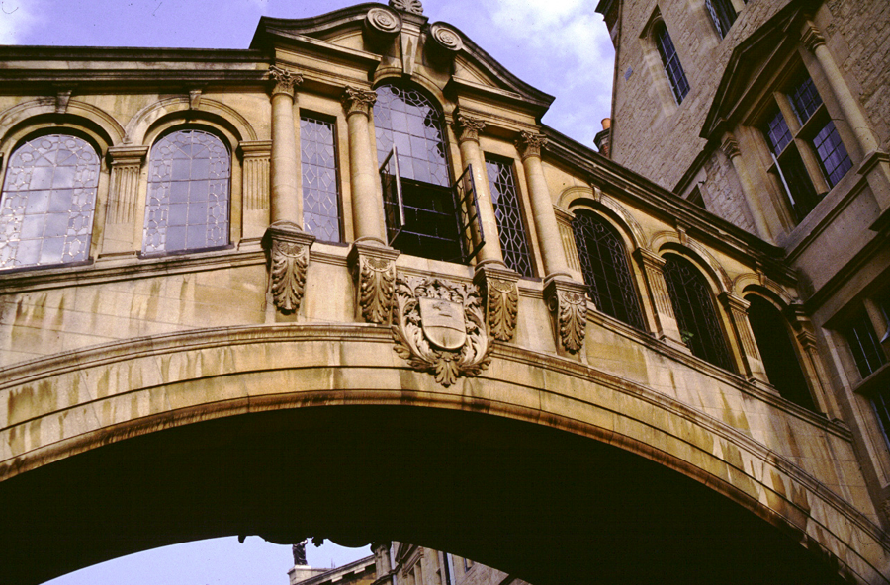
Bruce George
Department of Colorectal Surgery John Radcliffe Hospital, Oxford

Slide 2
Pouch failure
Excision/indefinite diversion:
9.3% at 5 years
16.1% at 10 years

Slide 3
Do failure rates understate the real problem?
4 4 2

Slide 4
Pouch specific
Pouchitis 18.8%
Pelvic sepsis 9.5%
Stricture 9.2%
Fistula 5.5%
Non-specific
Small bowel obstruction 8% re-op
Incisional hernia 11% re-op
62%

Slide 5
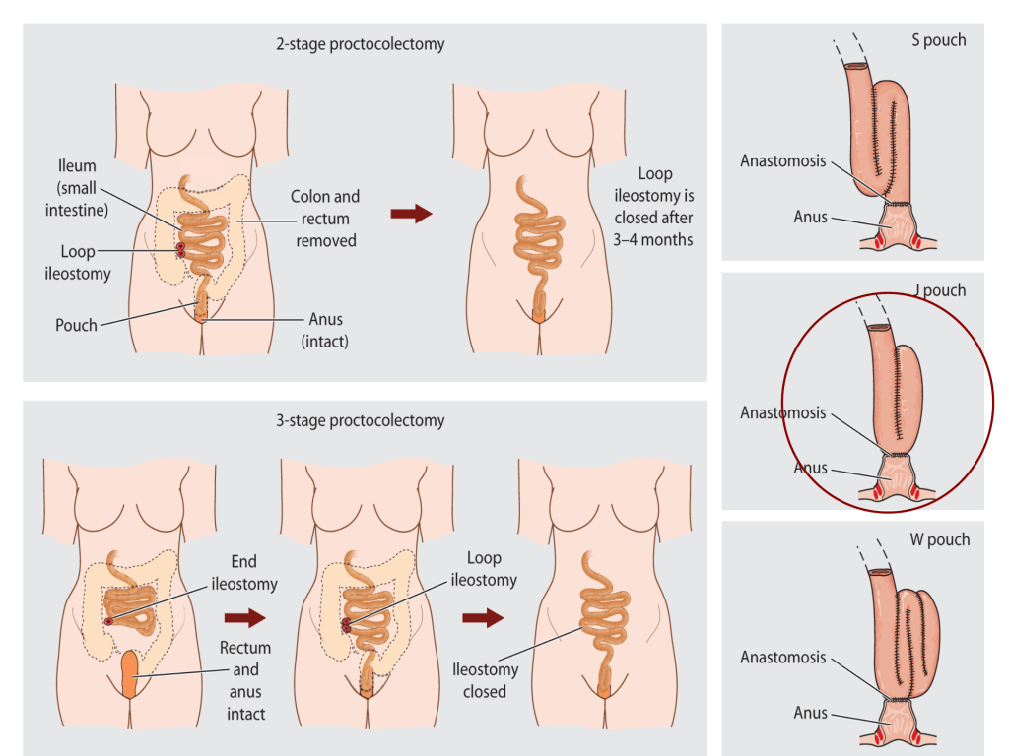

Slide 6
Potential surgical interventions
Early worries
sepsis
Maintenance
Pouchoscopy
Common problems
Stricture
Abscess/collection
Fistula
General surgical
Small bowel obstruction (8%)
Hernias (11%)
Ileostomy
Diverting ileostomy
Re-do pouch surgery
Pouch removal

Slide 7
Early worries Presentation of anastomotic leaks
Obvious
peritonitis
pelvic abscess
fistula
Subtle
fever/tachycardia/leucocytosis
Medical
cardiac arrythmias/respiratory symptoms
Late
42% on re-admission to hospital, 12% >30 days (Hyman et al 2007)
Incidental
contrast enema

Slide 8
Assessment of suspected early leak
High index of suspicion
CT with “rectal” contrast
EUA

Slide 9
Treatment of early leak
EUA ? Routine
Early drainage
Trans-anal (low)
CT guided (abdominal)
endosponge
? Re-suture/advance

Slide 10
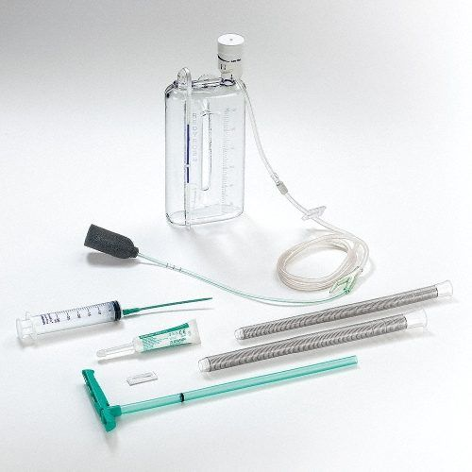
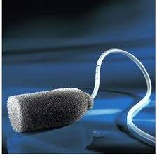

Slide 11
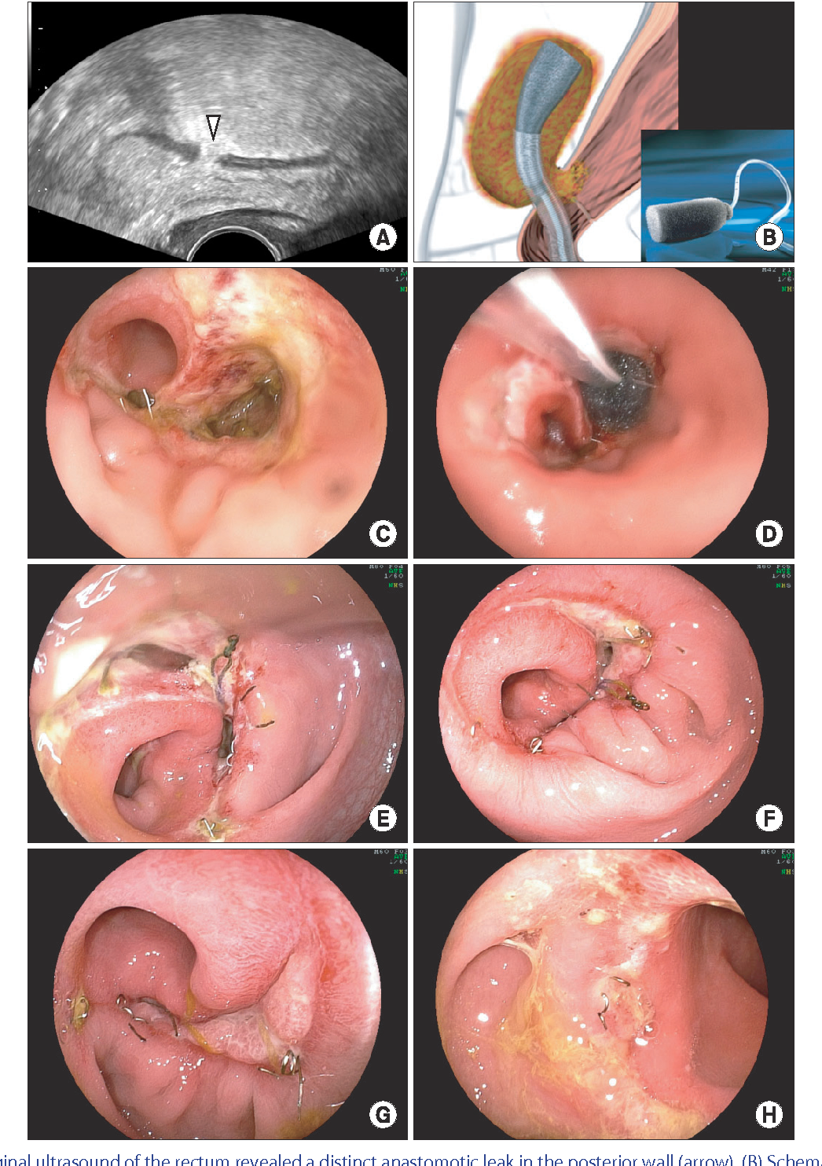

Slide 12
Maintenance
Routine pouchoscopy
If dysplasia, FH or PSC
Not routine ?
If deterioration in function

Slide 13
Deterioration in function
History
Clinical examination
PR
Pouchoscopy + biopsy
Stool culture
? Examination under anaesthetic (EUA)

Slide 14
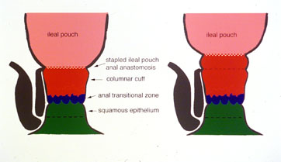
Common problems
Acute pouchitis
Ciprofloxacin 2w
Pouch-anal anastomotic stricture
EUA/endoscopy + gentle dilatation
Cuffitis
topical steroids or mesalazine

Slide 15
Persisting poor function
Inside
Flexible pouchoscopy + biopsy
pouchogram
Outside
CT or MR pelvis
Below
Sphincter physiology and ultrasound
Pouchogram
EUA, pouch and cuff biopsies
Above
MRE
endoscopy
Emptying the pouch
Dynamic evacuating “proctography”

Slide 16
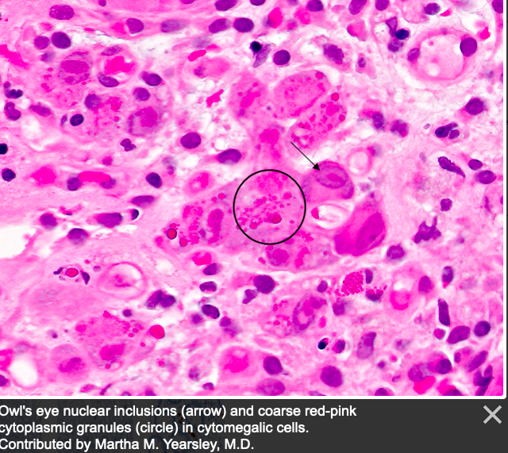
INSIDE THE POUCH
Inflammation
Cuff/body/pre-pouch ileum
Compliance and size
Ischaemia
Cmv/c. diff
Collagenous pouchitis

Slide 17
Assess the pre-pouch ileum

Slide 18
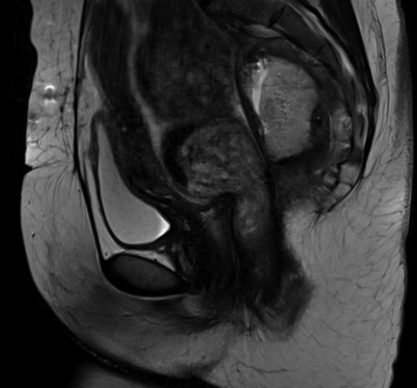
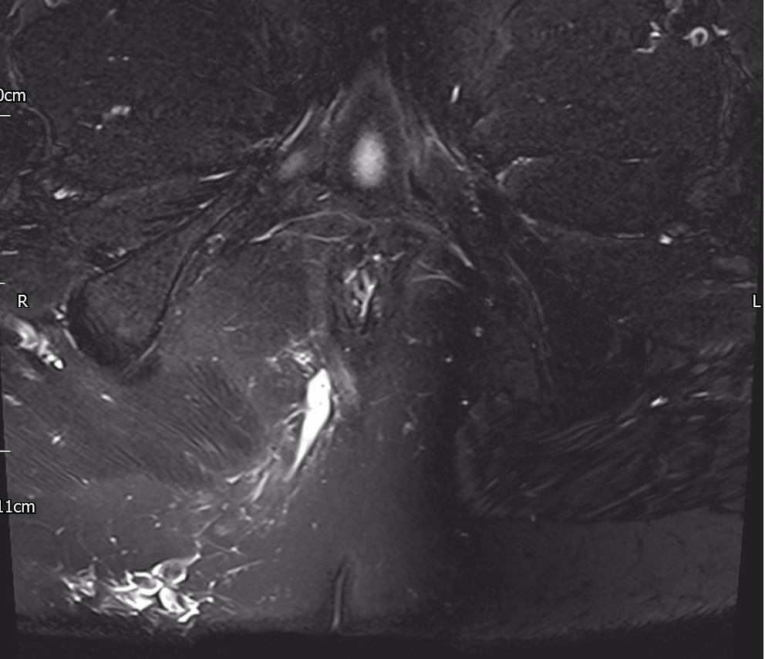
OUTSIDE THE POUCH
Pelvic abscess/induration
Fistula
Unrelated pathology
Fibroid, desmoid

Slide 19
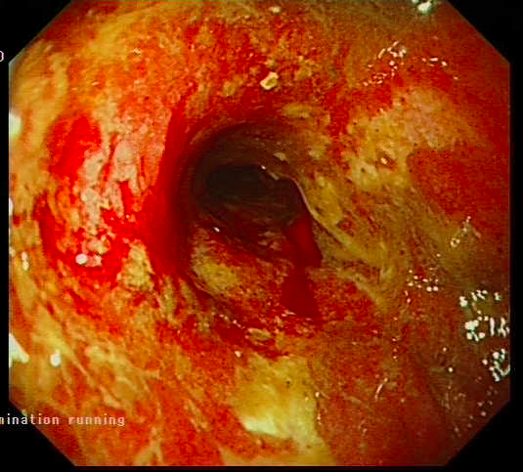
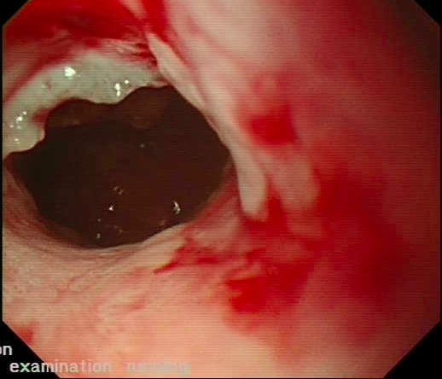
Below the pouch
Stenosis/induration at anastomosis
Pouch-vaginal fistula
Sphincter weakness
Cuffitis
Long rectal cuff

Slide 20
ABOVE THE POUCH
Adhesions
Bacterial overgrowth
Crohn’s disease
Pre-pouch ileitis
NSAIDs
coeliac

Slide 21
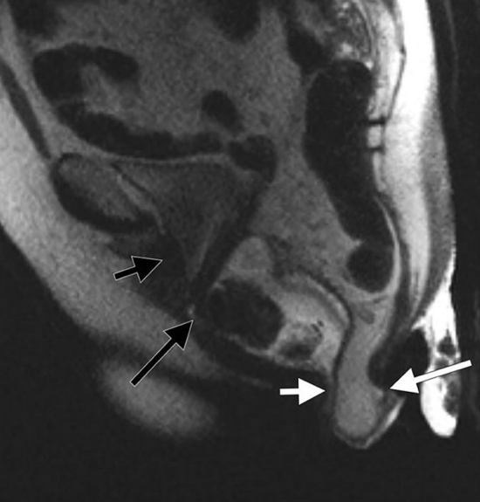
EMPTYING THE POUCH
Intussusception/prolapse
Anismus

Slide 22
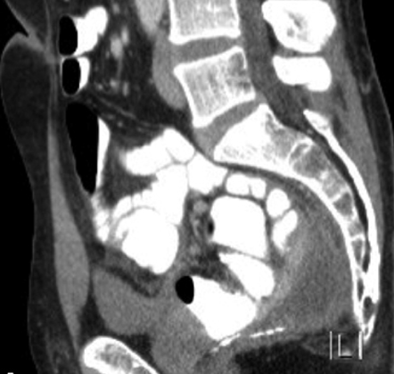
Common problems
Stricture at pouch-anal anastomosis
Self dilatation
Endoscopic dilatation
Surgical dilatation
Peri-pouch collection
Early vs late
Long term or cyclical antibiotics
Internal drainage (Endosponge)
Fistula
Early vs late
Seton drain(s)
Biologics

Slide 23
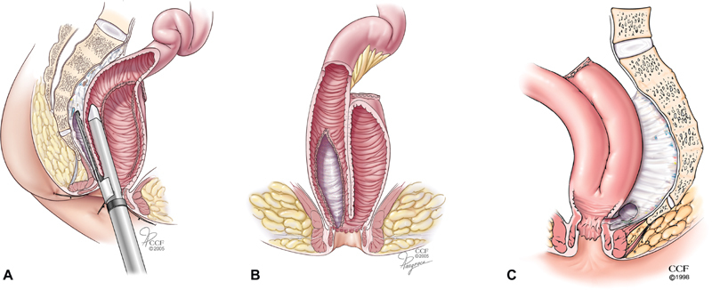

Slide 24
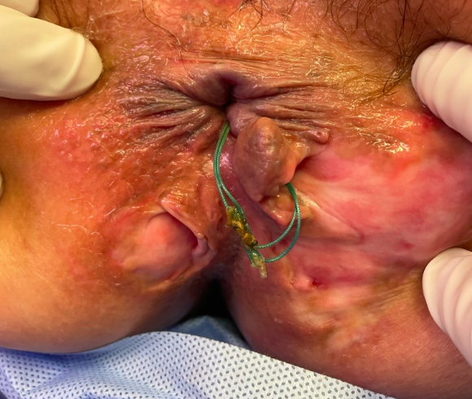

Slide 25
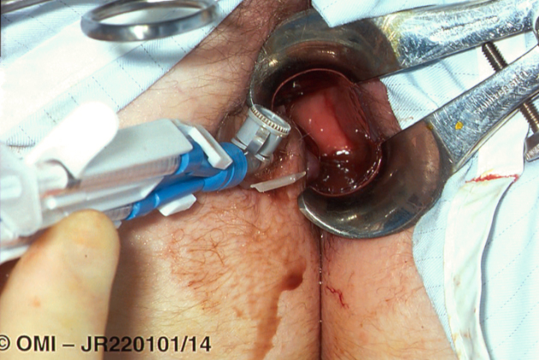
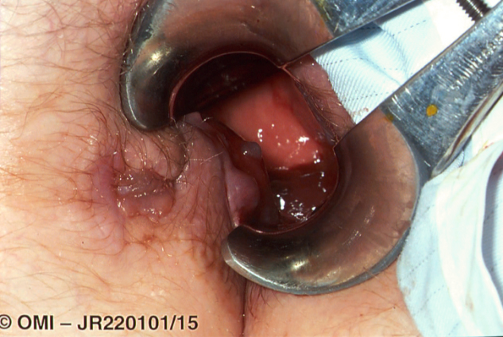

Slide 26
Inflammatory
IDIOPATHIC
SPECIFIC
Cuffitis
Pouchitis
Pre-pouch ileitis
Probable Crohn’s
Cmv
C. diff
collagenous
Specific treatment
Anti-inflammatory
Biologics

Slide 27
The failing pouch
Re-do pouch surgery
Ileostomy formation
Loop
End
Pouch excision

Slide 28
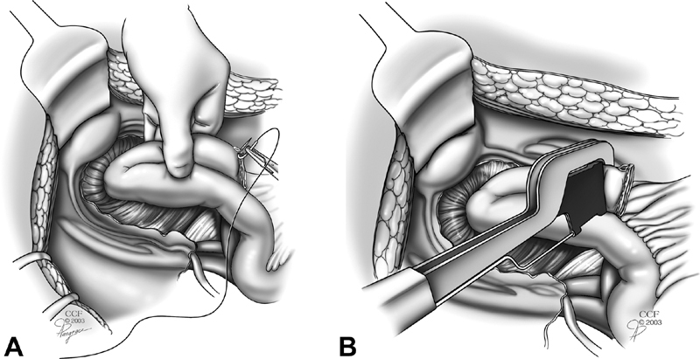
Technical
SEPTIC
NON-SEPTIC
Anastomotic fistula or sinus
Pre-sacral collection
ischaemia
Long columnar cuff
Twist
Stenosis
Pouch-anal
Pre pouch ileum-pouch
(leak from tip of J)
Intussusception
Indefinite diversion/pouch
excision
Endoscopic/EUA
Dilatation
Self catheterisation
Consider re-do pouch

Slide 29
Potential surgical interventions
Early worries
sepsis
Maintenance
Pouchoscopy
EUA
Common problems
Stricture
Abscess/collection
Fistula
General surgical
Small bowel obstruction (8%)
Hernias (11%)
Ileostomy
Diverting ileostomy
Re-do pouch surgery
Pouch removal

Slide 30
snapshot of 3 weeks work
20 patients with pouch
Drainage abdominal abscess 1 (2/52 post op)
EUA anal dilatation 5 (3,5,9,10 and 13 yrs post op)
Dilatation pre-pouch stricture 2 (15 and 20 yrs post op)
EUA fistula/peri-pouch sepsis 2 (15 and 29 yrs post op)
Ileostomy formation/revision 6 (3,10,10,16,25 and 40 yrs)
Excision for ca, defunction [3], loop to end, hernia
Miscellaneous 3 (9, 19 and 20 yrs)
Hernia, inflamm polyp, Kock pouch fistula
Nothing 1 (12 yrs)

