Slide 1
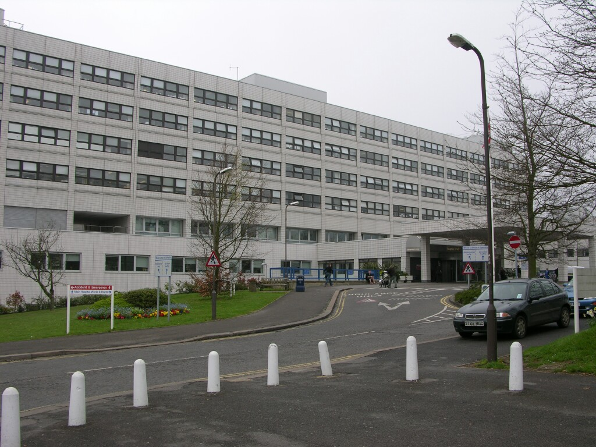
Nursing Pouch Support
Simon Turley, Senior Specialist Nurse, Colorectal Nursing Team, 08.10.2022

Slide 2
The Colorectal Nursing Team
Stomatherapy & Pouch
Colorectal Cancer
Pelvic Floor/ GI Physiology

Slide 3
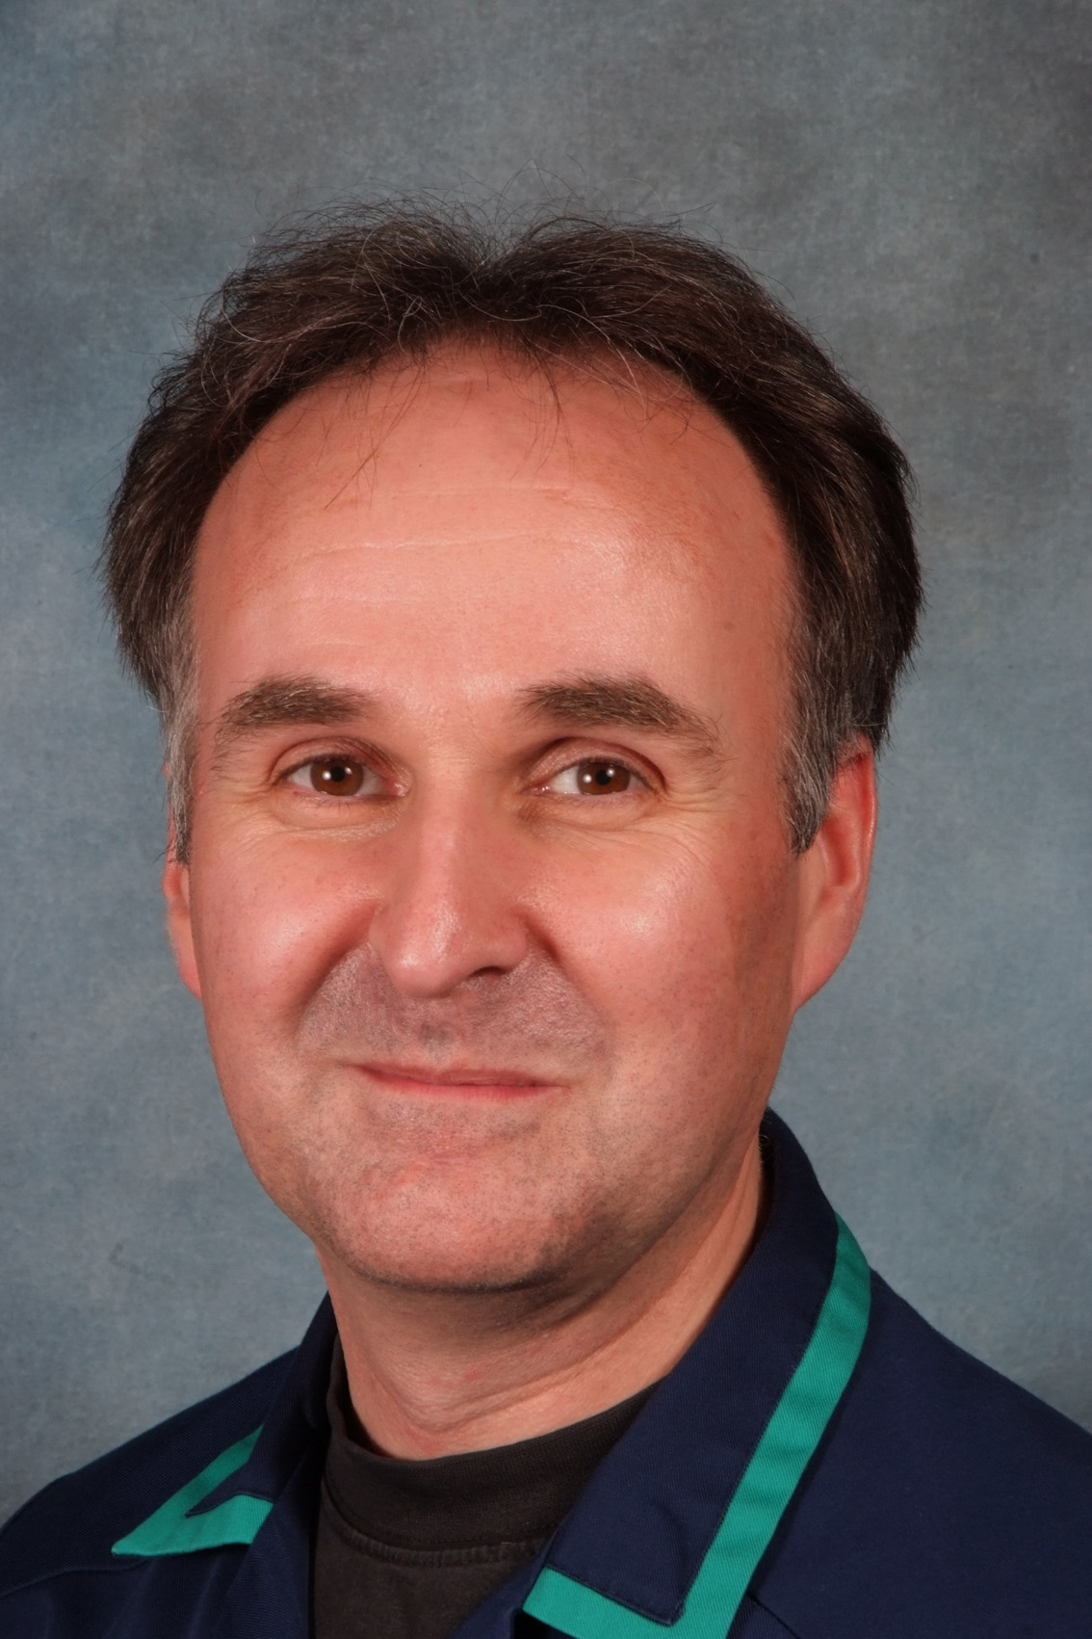
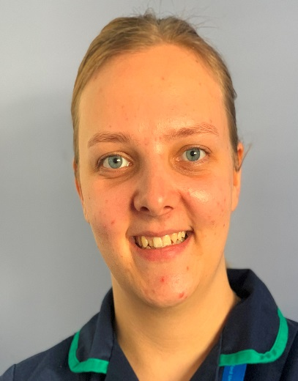
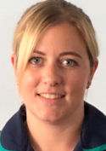
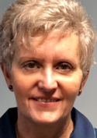
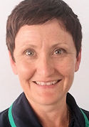
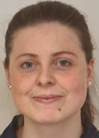
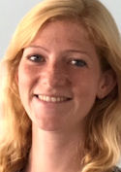
“The Stoma side of Colorectal Nursing”
Fran- 2000 1WTE Simon-2001 1WTE Jo- 2005 1WTE Jess (L)- 2021 1WTE
Senior Specialist Nurse Senior Specialist Nurse Senior Specialist Nurse Specialist Nurse
Cat- 2013 0.8 WTE Kim- 2013 0.66WTE Jodie- 2017 0.6 WTE Holly- 2021 0.8WTE Ellen- 2018 P/T
Senior Specialist Nurse Specialist Nurse Senior Specialist Nurse Specialist Nurse Administrator

Slide 4
Background to Pouch Service
First nurse-led pouch clinic in the UK was in Oxford in 2003. St Marks, London were running Pouch clinics with a Pouch nurse and consultant in 2003. The Oxford Pouch team has grown from 1 SCN solely running the clinic to 4 in 2012 and more recently to 5 SCN’s alternating clinics.

Slide 5
Current Pouch Service
Supporting our patients pre and post-operatively
To resume and establish a satisfactory lifestyle
Referral to pouch clinic after surgical post discharge review
Telemed- weekly telephone clinic
Adhoc telephone pouch advice/support
Collaborative support from Mr Bruce George, Miss Katherine Baker & Mr Mark Bignell & the Gastroenterologist’s

Slide 6
Review of Service / Future developments
Evolved over time – still providing appropriate function & support, demand/supply
Proposal:
Pouch clinics will potentially change from January 2023
Surgical referral to pouch clinic for new IAP pts after post discharge review
First review in Pouch clinic from 6 months (once completed surgical follow up), followed by a 12 month review
Continuation of adhoc telephone pouch advice/support
Audit and review the process

Slide 7
Don’t forget your blood test!
With the change in Pouch clinic, it is now your responsibility to ensure that you have a routine yearly blood test for the following. This can be arranged with your local GP practice or if live in Oxfordshire are requested by pouch nursing team and taken by GP practice.
Full Blood Count
Urea and Electrolytes
Vitamin B 12
Ferritin and Folate
Liver Function Test
Please ensure that the result is sent through to us FAO Pouch Nurses to
colorectal.nursing@nhs.net

Slide 8
Team Contact Details
Stoma / Colorectal Nursing Team
Level 6
John Radcliffe Hospital
Headington
OXFORD
OX3 9DU
Tel: 01865 221839
Stoma / Colorectal Nursing Team
Surgery & Diagnostics
Level 2
Cancer Centre
Churchill Hospital
Headington
Oxford
OX3 7LJ
Tel: 01865 235367
Email: colorectal.nursing@ouh.nhs.uk
colorectal.nursing@nhs.net

Slide 9
Thank you for listening
Any Questions?

