Slide 1

Diet for Good and Continuing Pouch Function
Clemmie Oliver
IBD Specialist Nutritionist
MSc, ANutr, DipION, mBANT, CNHC
Clemmie Oliver | NALM Clinic

Slide 2
Clemmie Oliver
Founder of The Nutrition & Lifestyle Medicine (NALM) Clinic - Specialist IBD Nutrition & Dietetics Clinic
Registered Associate Nutritionist (MSc, ANutr, AfN)
Registered Nutritional Therapist (DipION, mBANT, CNHC)
Nutrition Advisor for Crohns & Colitis UK & IBD Relief
Ambassador for Bowel Disease UK
IBD & J Pouch Patient
Clemmie Oliver | NALM Clinic

Slide 3

What we will cover today
How diet can support the different stages of our pouch journey:
    Pre-surgery - preparation
    Post-surgery - recovery
    On-going diet - support pouch health, function and symptoms
    Q & A
1
2
3
Clemmie Oliver | NALM Clinic

Slide 4
1
Pre-Surgery
Before J-Pouch surgery (also known as 'pre-habilitation’), we need to focus on "eating well" i.e. maintaining a balanced diet.
This will help to:
  Provide our body with the nutrients it needs
  Optimise our energy levels and strength prior to surgery
  Prevent us from being malnourished, which can delay recovery
Eating as well as possible and being well nourished reduces:
1) risks of post-op complications
2) length of stay in hospital
Clemmie Oliver | NALM Clinic

Slide 5

1
Pre-Surgery - Balanced Diet
Check you’re meeting British Dietetics Association (BDA) & IBD guidelines:
  Eat 5 fruit and veg a day - including pulses
  Eat 2 portions of fish per week - 1 portion should be an oily fish or 4 portions plant-based equivalent like flaxseed, soya etc.
  Prioritise wholegrain and fibrous carbohydrates - brown bread, wholemeal pasta, legumes etc. if you are able to tolerate them
  Limit red meat to less than 250g per week
  Limit saturated fat to less than 20-30g per day
  Limit salt to less than 6g/1 tsp per day - be mindful of hidden added salt
  Limit sugar to less than 30g per day/6 tsp - be mindful of hidden added sugar
  Drink 6-8 large glasses of water a day - equiv. to 2-3 litres
Notes:
If you are struggling with weight loss or getting enough food in each day, your Dietetics team may support you with supplement drinks. Ask your surgeon/surgical team about these as they can either be prescribed or purchased over the counter.

Slide 6
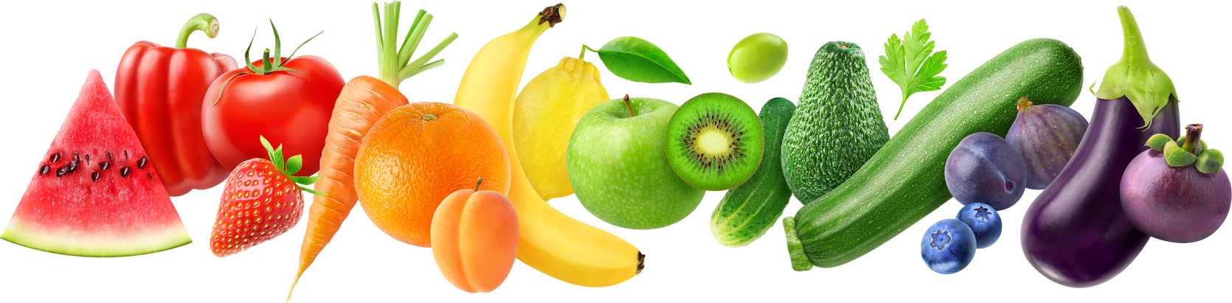
2
Post-Surgery - Low Fibre Diet
Foods that are easily digested and absorbed, leaving minimal residue in the bowel for 4-8 weeks, depending on your progress/complications.
Dietary fibre comes from plant foods.
There are two types to consider when following a low fibre diet:
  Insoluble
  Soluble
Continue to eat a healthy balanced diet post-surgery to support recovery –
Protein, fruit & vegetables (tinned, cooked, blended for tolerance)
Clemmie Oliver | NALM Clinic

Slide 7
2
Post-Surgery - low fibre diet - Veg
Food group | Suitable foods | Foods to eat to tolerance | Foods to avoid
Veg | Well-cooked or pureed root vegetables such as carrots, parsnips, turnips or swede Tomatoes without skins or seeds such as tomato juice, canned deseeded tomatoes, passata, tomato puree Vegetable juices or soups ± sieved to get rid of any seeds/ skins] Avocado | Well-cooked vegetables, with no stringy parts or stalks. Examples include: cauliflower, sprouts, broccoli, pumpkin, aubergine, courgette, peppers without skins. Cucumber without skin or seeds | All vegetable stalks, skins, seeds and peel Sweet corn, broad beans, runner beans, mange tout, sugar snap peas Raw vegetables such as peppers, radishes and celery, tomatoes Cabbage, leeks, onions Lettuce, spinach and salad leaves
Clemmie Oliver | NALM Clinic

Slide 8
2
Post-Surgery - low fibre diet - Fruit
Food group | Suitable foods | Foods to eat to tolerance | Foods to avoid
Fruit | Fruit juice or smoothies (no seeds / pips / skins / piths). Cooked or stewed fruit without skin Melon, banana Canned pears, peaches or apricots, canned citrus fruit with no pith, skin or pips such as mandarins or grapefruit Pureed fruit / fruit coulis (sieved) | Peeled fruit with no pips/seeds such as pears, apples, peaches, grapes, plums, apricots, mango, grapefruit, oranges, clementine | All dried fruit Any fruit skins, pips or seeds Strawberries, raspberries, blueberries, blackcurrants, gooseberries passion fruit, pineapple, kiwi, mango, apricots
Clemmie Oliver | NALM Clinic

Slide 9
3
On-going diet - Supporting pouch health & function
Food and drinks can affect:
  The speed at which foods moves through our small intestine - either speeding it up or slowing it down
How much water is drawn into and absorbed out of our small intestine
  What is available for the microbes in our pouch to ferment
Clemmie Oliver | NALM Clinic

Slide 10
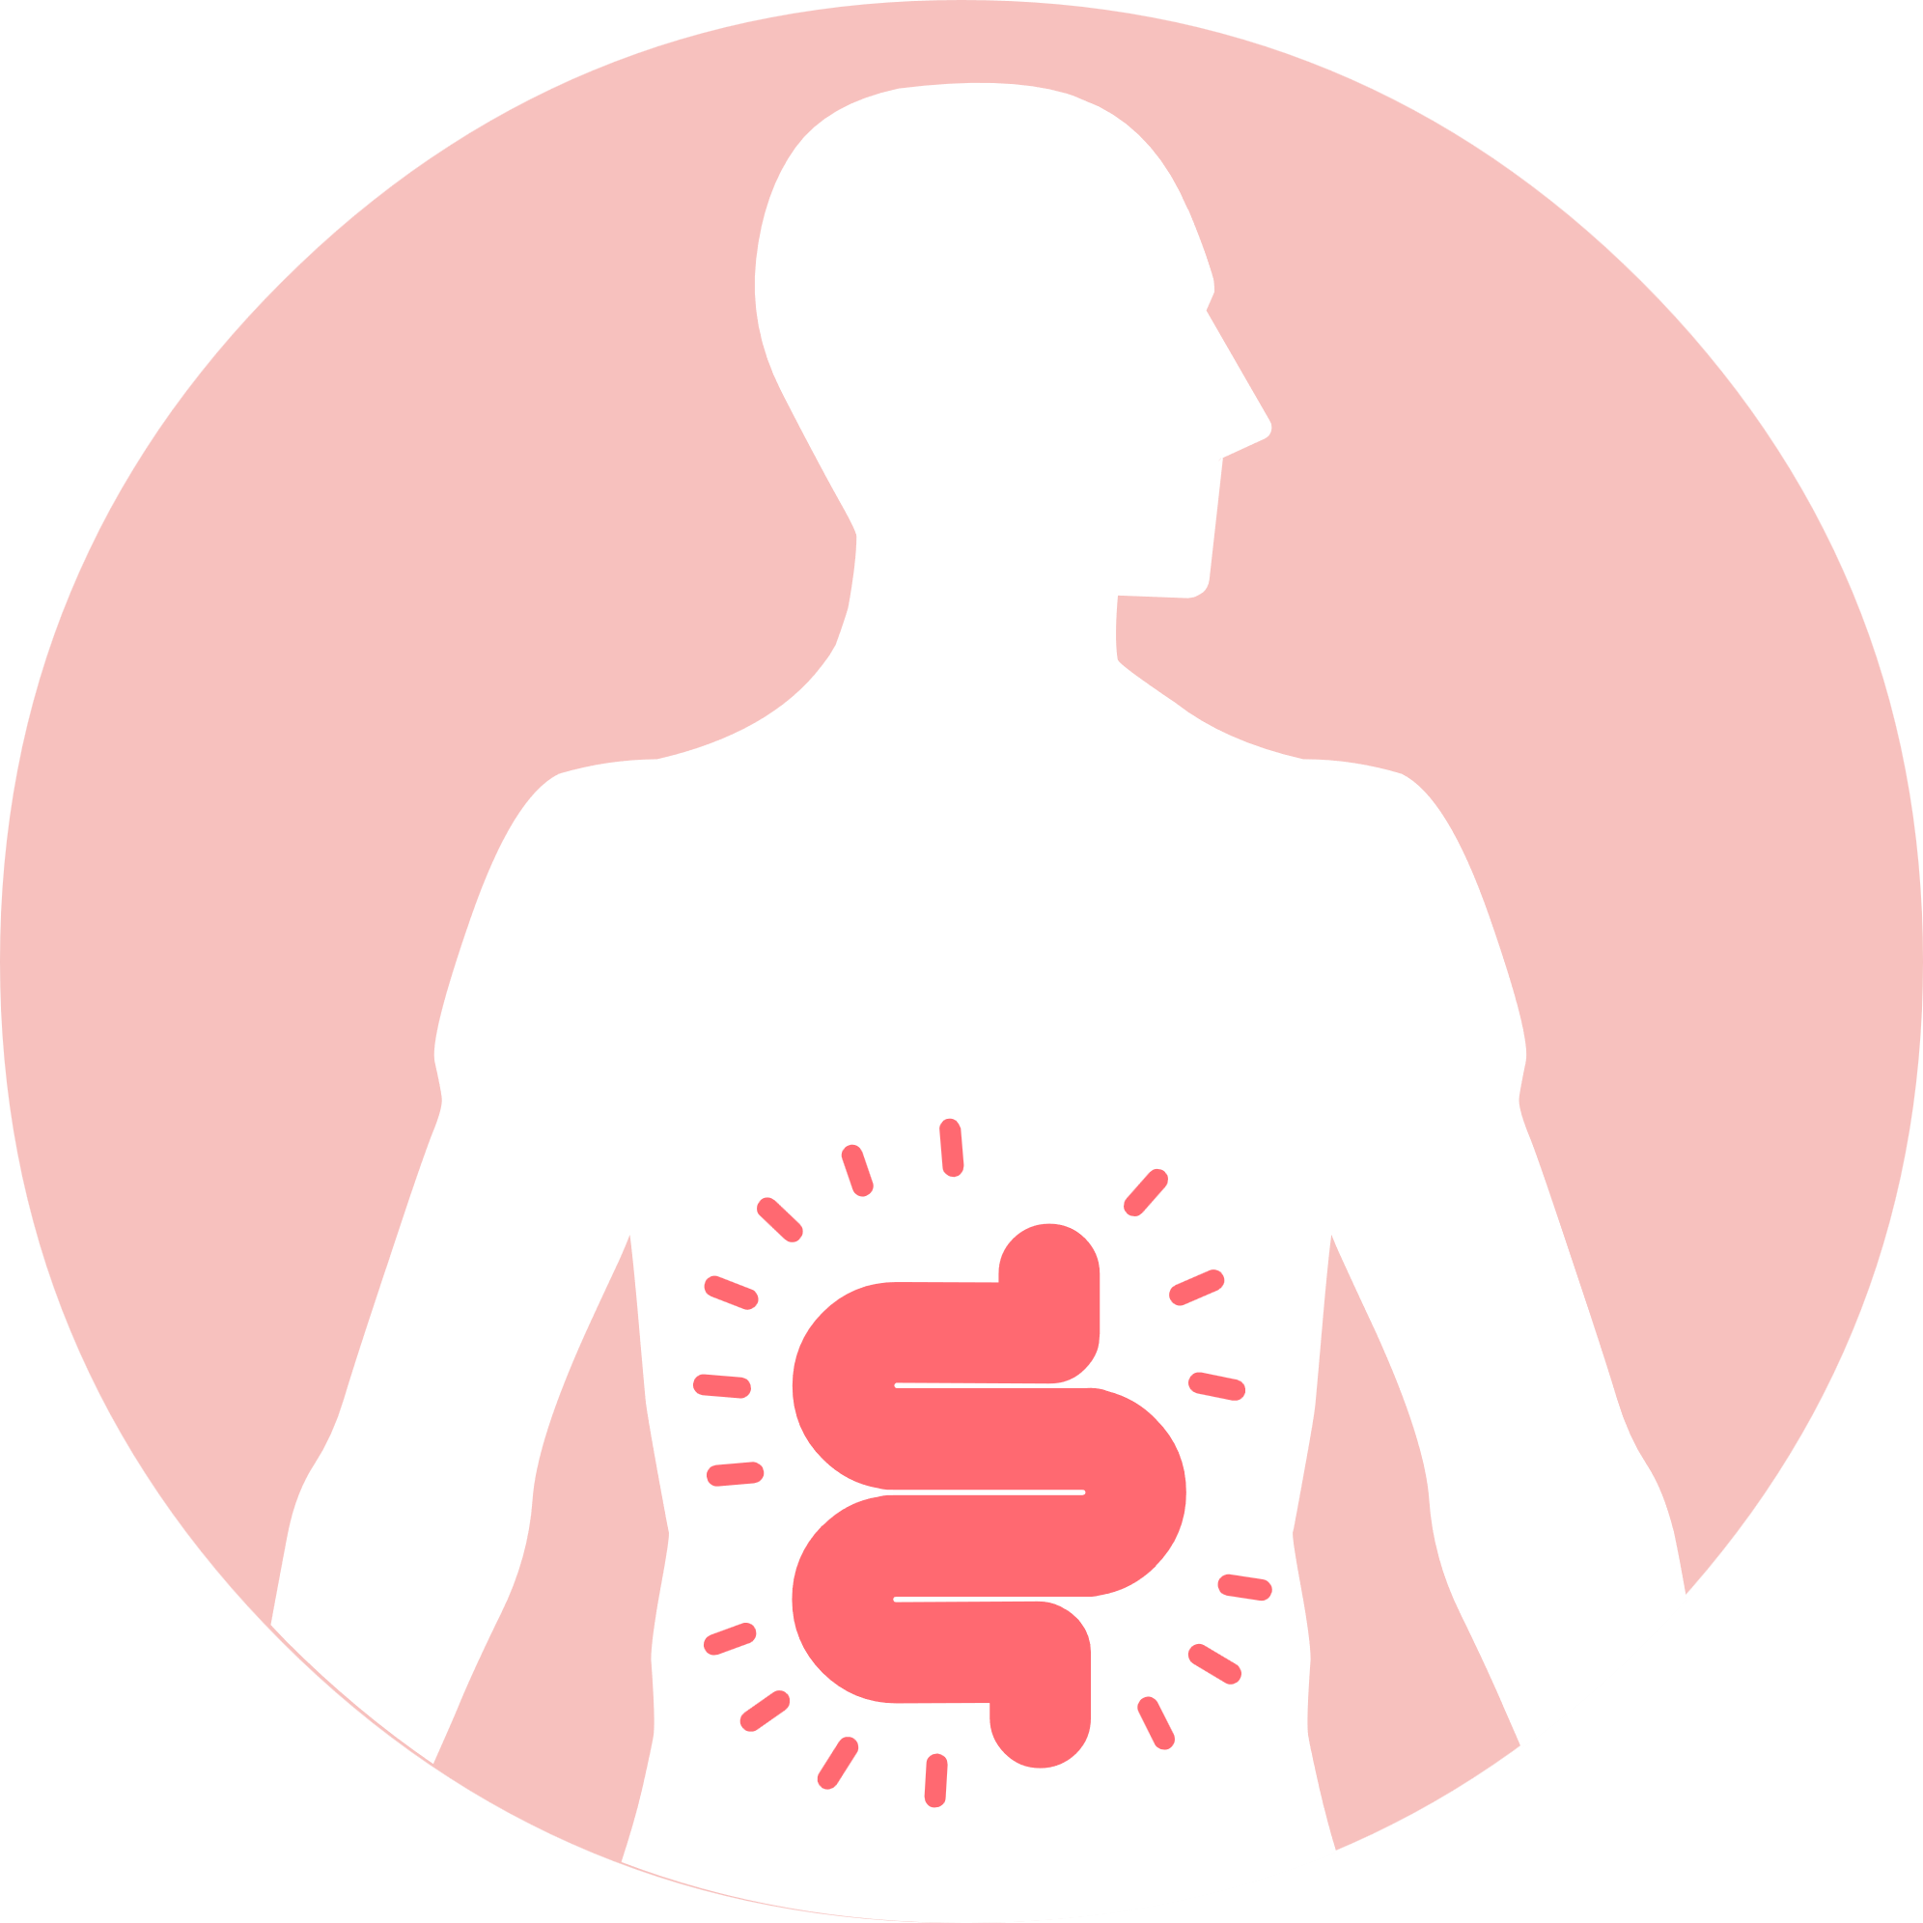
3
On-going diet - Supporting pouch health & function
All the these are likely to play interacting roles in the:
  Amount we empty our pouch
  Consistency of our stools
  Pouch function / health
Managing bowel symptoms: Diet can help manage consistency of bowel movements, bloating, gas, pain, diarrhoea and constipation
Clemmie Oliver | NALM Clinic

Slide 11
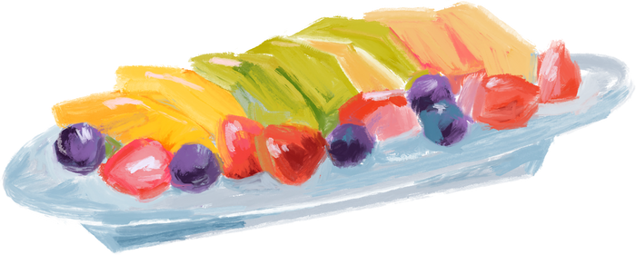
3
On-going diet - The Mediterranean Diet
Research has shown that the Mediterranean Diet and fruit consumption with a J Pouch is associated with:
  Decreased calprotectin levels
  Lower rates of pouchitis
  Better pouch microbial diversity
This is possibly due to the fibre and antioxidant content.
Clemmie Oliver | NALM Clinic
Notes:
However, J pouch patients tend to have a significantly different diet to the healthy individuals and more so with pouchitis (e.g lower fruit and veg consumption).
Research published in the European Journal of Nutrition in 2020 reported that following a Mediterranean diet pattern was associated with decreased calprotectin levels and lower rates of pouchitis over time.
Another study published in 2019 found that fruit consumption correlated with pouch microbial diversity and lower rates of pouchitis.
Although we don’t know exactly why these dietary patterns are associated with better pouch health, it is hypothesised that the benefit could relate to their fibre and antioxidant content.
It is important to note that these studies have their limitations, mainly that they are observational studies so do not provide cause and effect, only associations, so there isn’t enough evidence yet to say with certainty that a Mediterranean diet pattern or increasing fruit intake will reduce the risk of pouchitis. Luckily there are some trials in progress looking at the causal relationships and I am eagerly awaiting their publication.
Whilst we don’t know yet the cause and effect of these, practically we know that following a Mediterranean pattern of eating or increasing fruit intake can have multiple benefits on our health beyond the health of our pouch (e.g. reduce risk of diseases like heart disease and diabetes) and is SAFE.
In addition, wider research suggests that plant diversity is key when it comes to supporting the health and diversity of the bacterial communities that live in our gut.

Slide 12
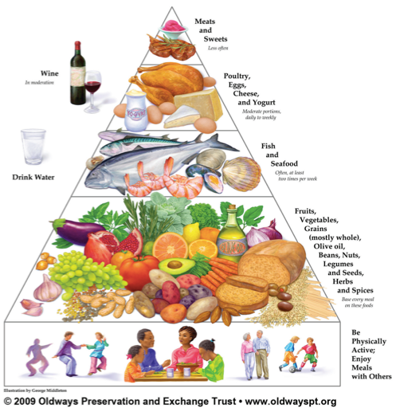
3
On-going diet - The Mediterranean Diet
A Mediterranean dietary pattern encourages the consumption of:
Vegetables
Fruits
Whole grains
Nuts
Legumes
Olive oil
All which contribute to the overall intake of valuable micronutrients.
Notes:
How many people are thinking yeah right?! That’s so far away from my current diet, I could never eat like that.

Slide 13
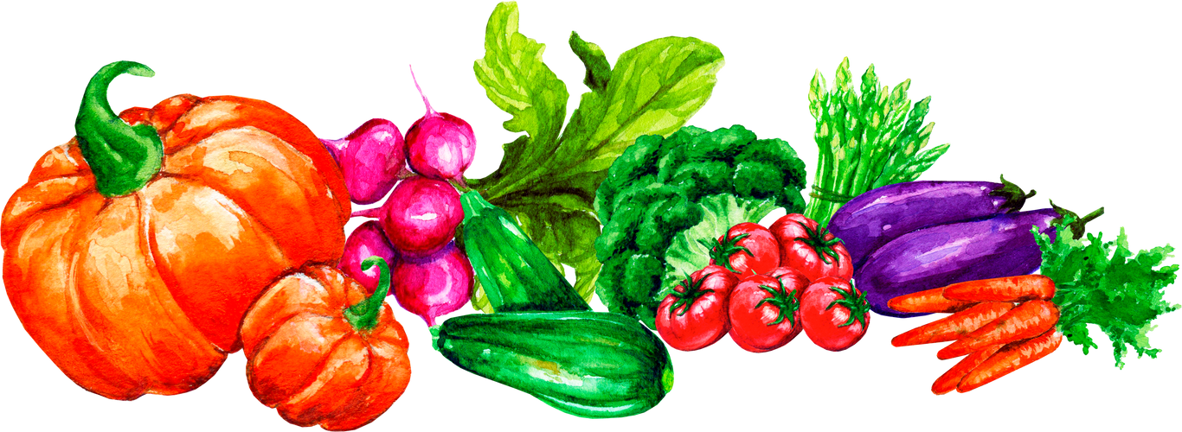
3
On-going diet - The Mediterranean Diet
Adapting the Mediterranean diet for a J pouch:
  Increase fruit, vegetables and grains slowly – e.g. 1 portion every 2-3 days
  Start with a small amount and work up – e.g. 1/3 - 2/3 - 1 whole portion
  Adapt textures initially – e.g. cook, remove skins, blend; whole nuts -> nut butters; Smoothies and soups can be helpful ways to blend and soften textures.
  Focus on soluble fibre containing foods to help manage pouch output - e.g. oats, apples, pears, stone fruit, avocado, root vegetables etc.
Clemmie Oliver | NALM Clinic
Notes:
NB: if you are post-surgery or have strictures or other complications:
please seek personalised support and advice before making dietary changes

Slide 14
3
On-going diet - Symptom triggers
Important to remember a J pouch can take 6-12 months to settle.
Identify if you have any trigger foods or drinks and adapt / swap accordingly.
There are some common symptom trigger foods/drinks:
Clemmie Oliver | NALM Clinic

Slide 15
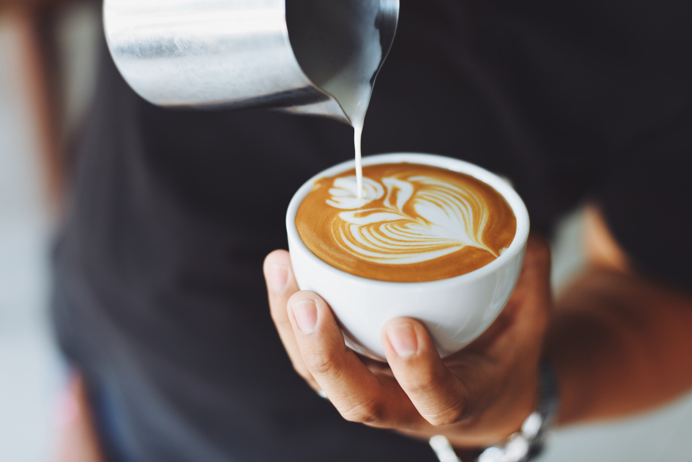
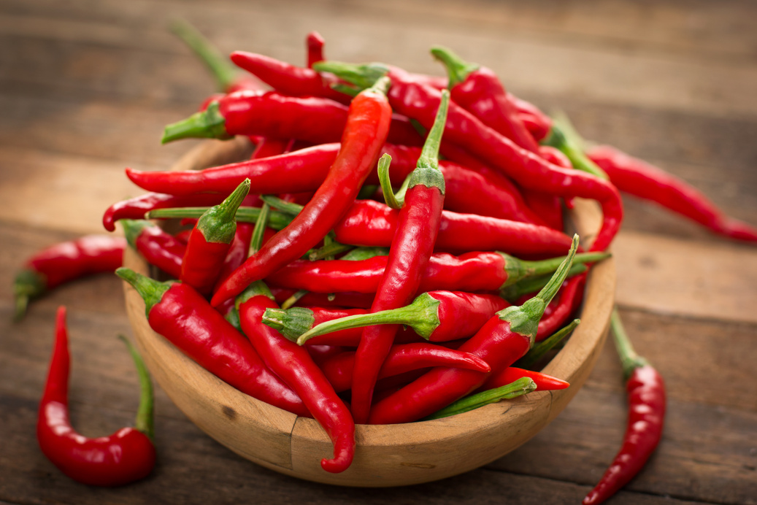
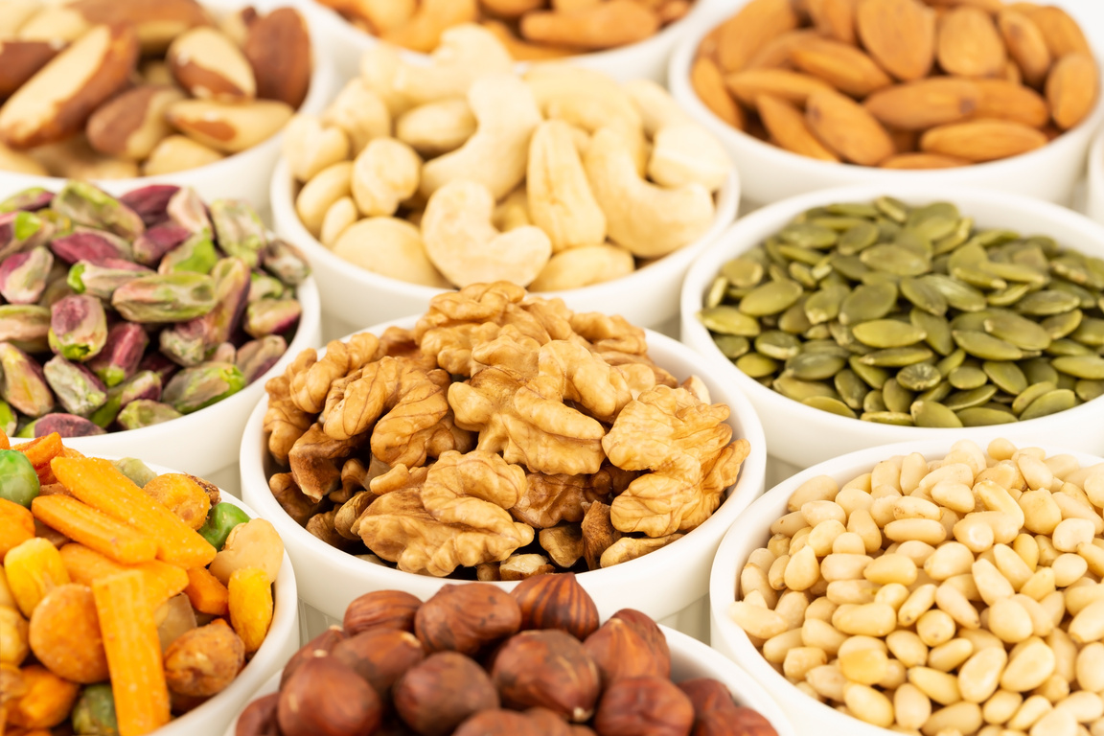
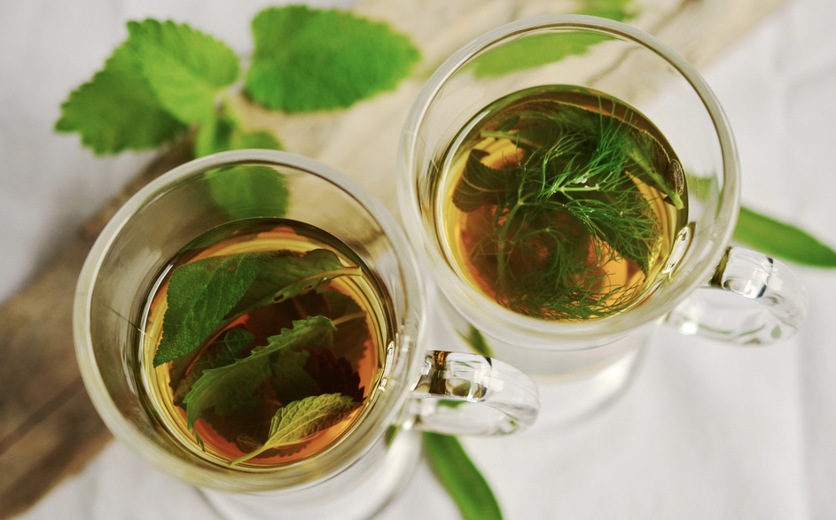
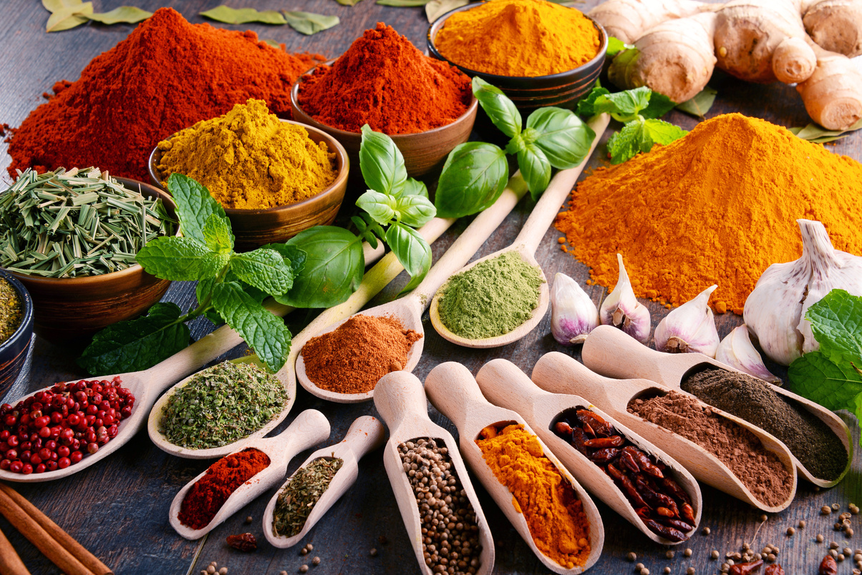
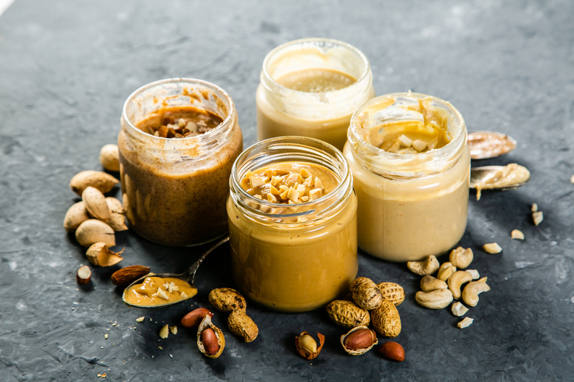
3
On-going diet - Symptom triggers
Coffee/caffeine drinks
Spicy food and chilli
Whole nuts and seeds
Instead try
Smooth nut & seed butters
ground/milled nut & seed flours
Fresh herbs and aromatic spices
like parsley, basil, turmeric & cumin
Herbal tea/caffeine free drinks
Clemmie Oliver | NALM Clinic
Notes:
Coffee/caffeine - increased bowel movements and urgency -> switch to non-caffeinated drinks
Spicy food - butt burn, urgency, and increased bowel movement frequency -> choose herbs and aromatic spices to flavour food
Nuts and seeds - irritation –> adapt textures – nut butters, ground nuts/seeds

Slide 16
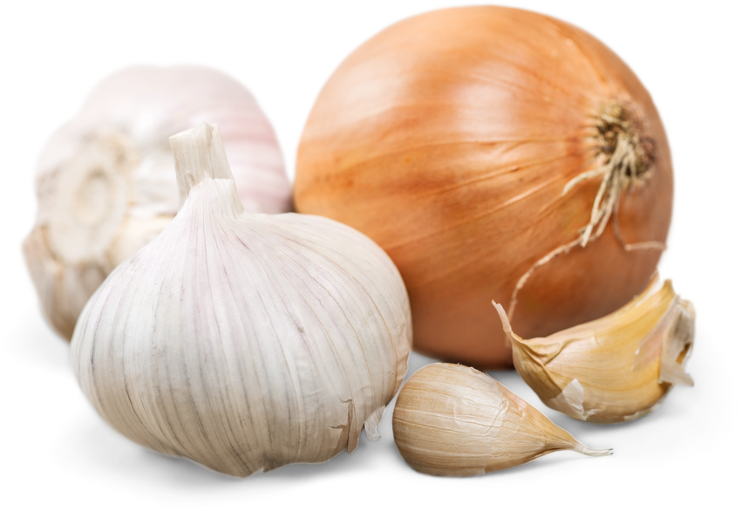
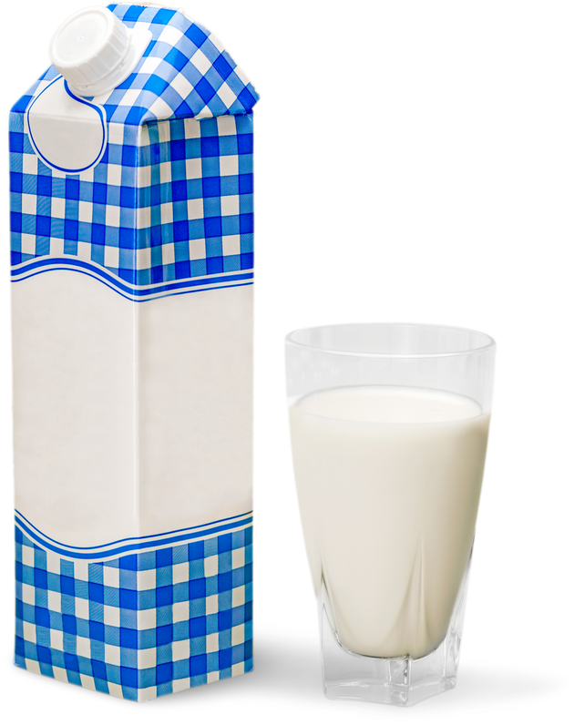
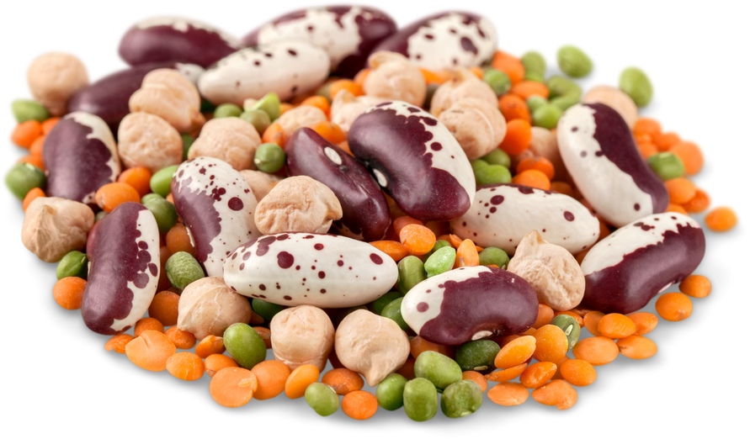
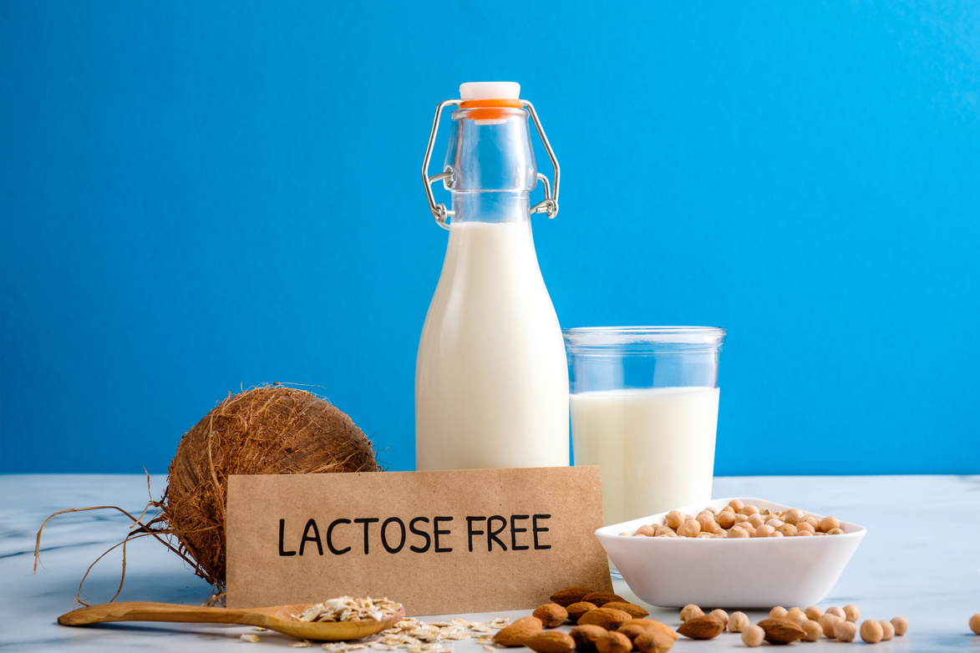
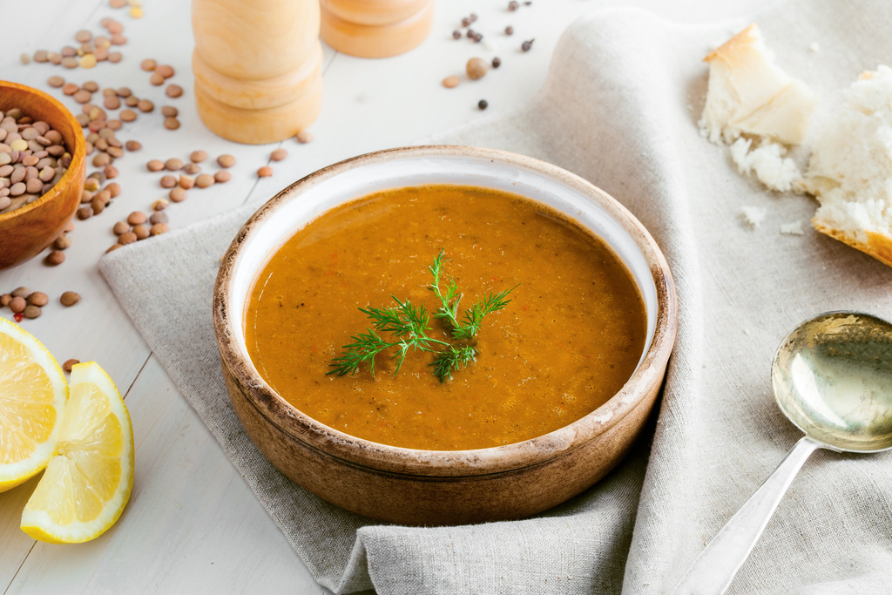
3
On-going diet - Symptom triggers
Milk, cream, ice cream
Legumes, onions and garlic
Instead try
Blended into soups
Legume flours, legume pastas.
Small amounts increasing
Lactose free / low lactose dairy / fortified alternatives
Clemmie Oliver | NALM Clinic
Notes:
Dairy - diarrhoea and gas –> try lactose free / low lactose dairy
Onions, garlic, legumes - bloating, gas –> try increasing slowly over several weeks/months and consider seeking specialist dietary support

Slide 17
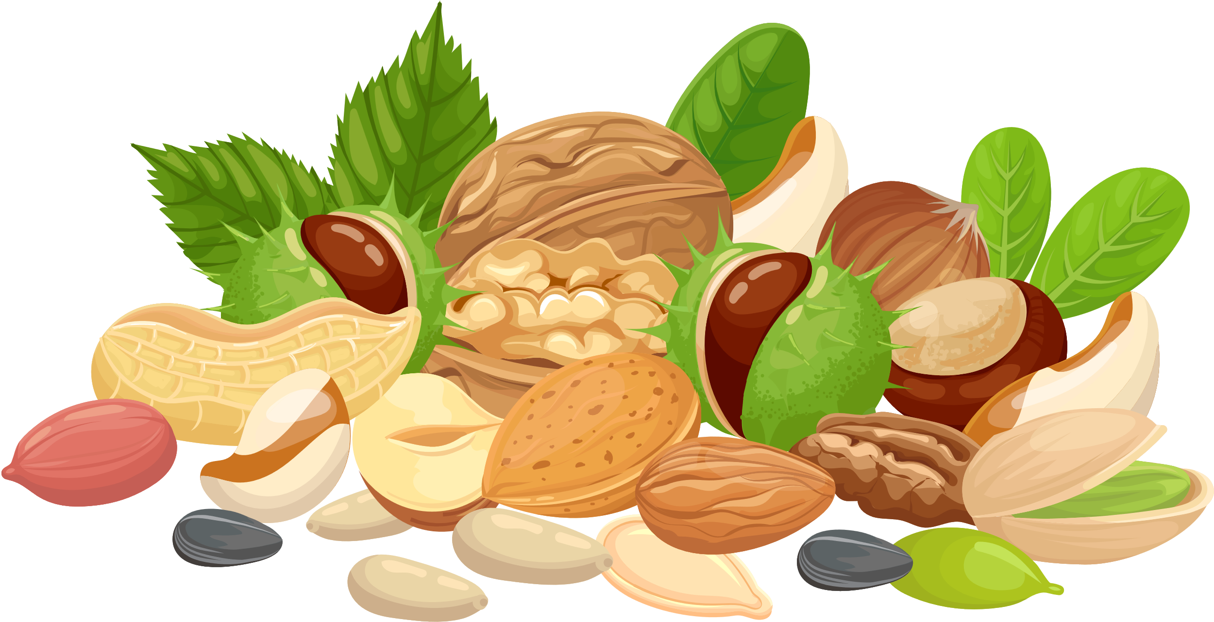

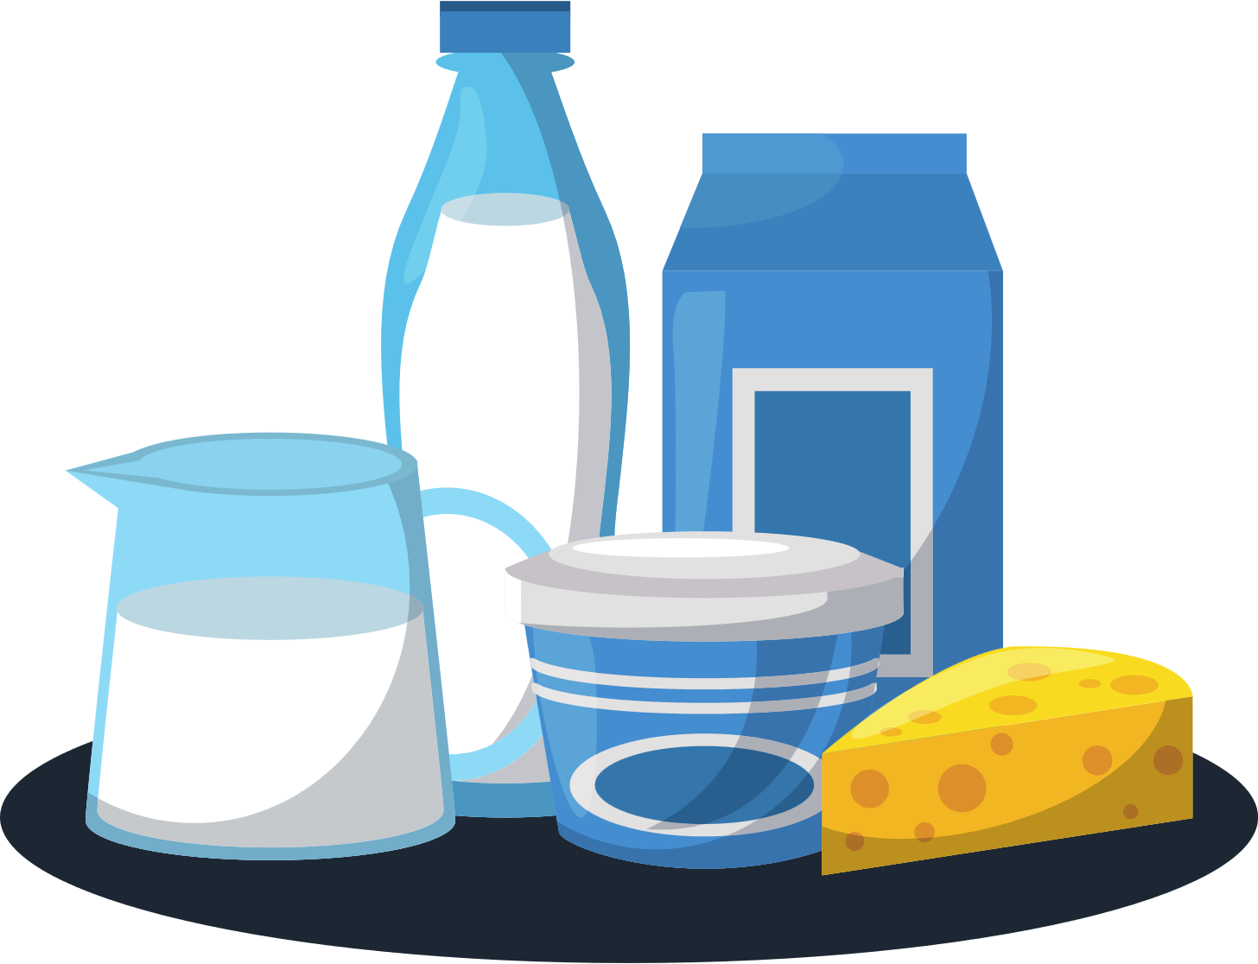
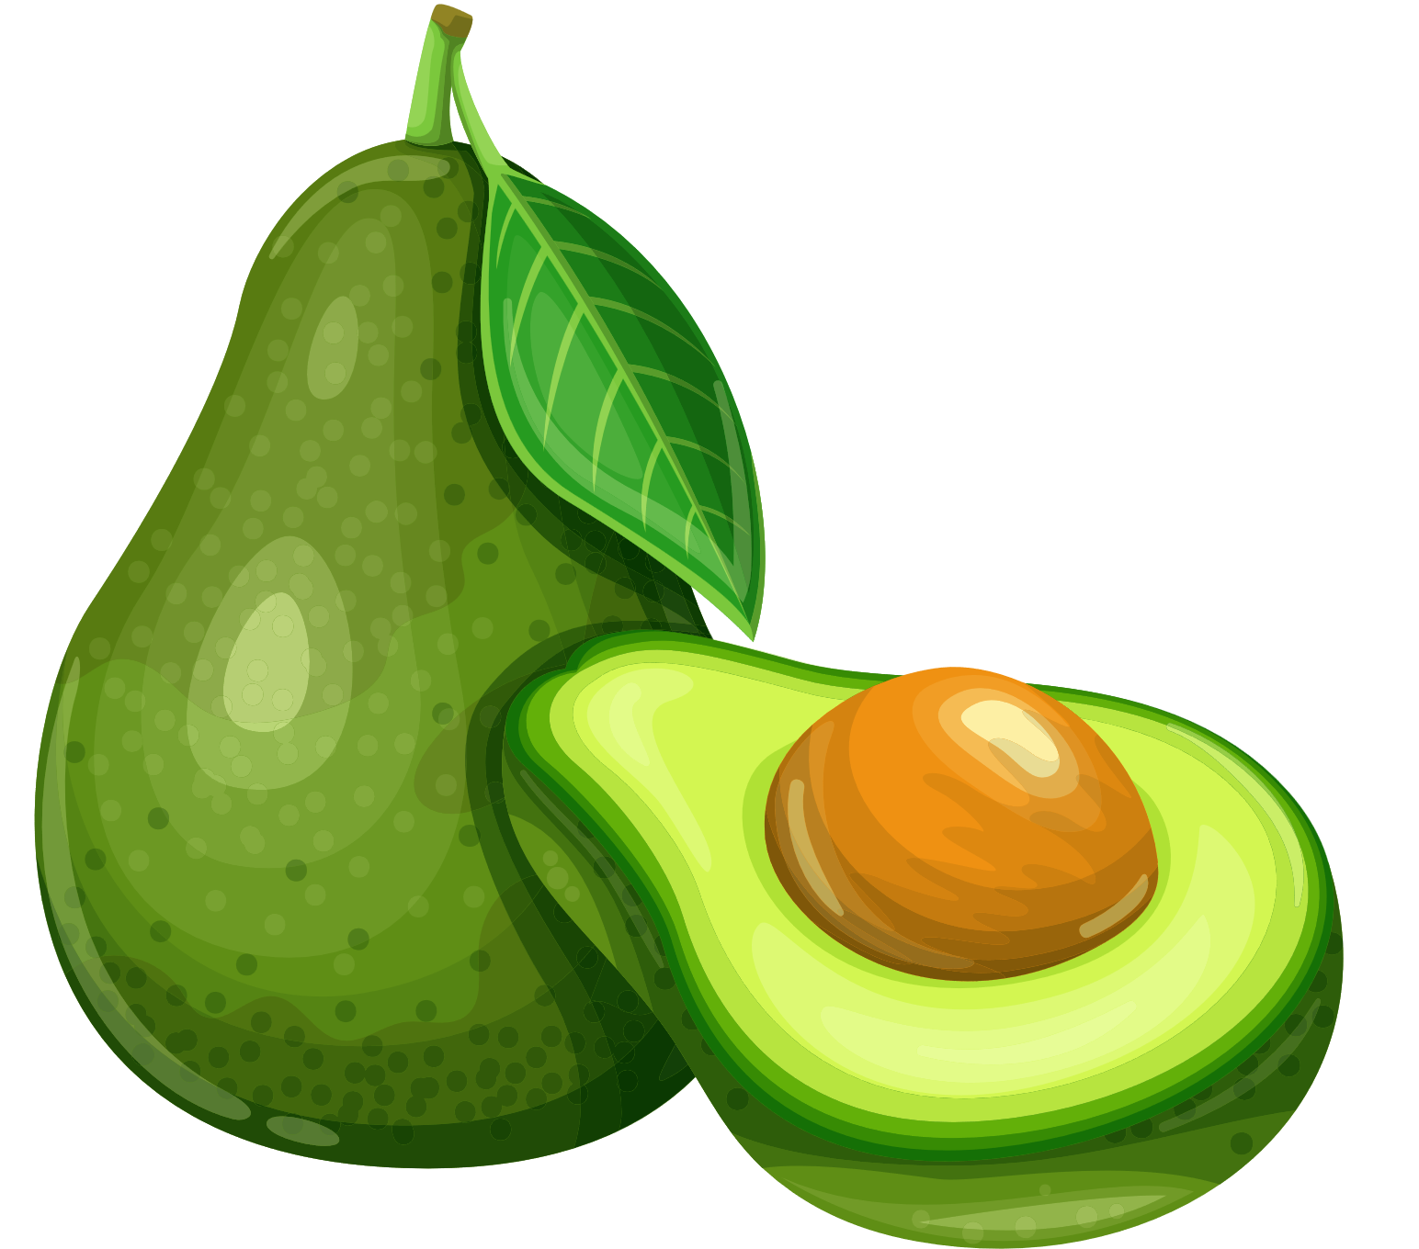
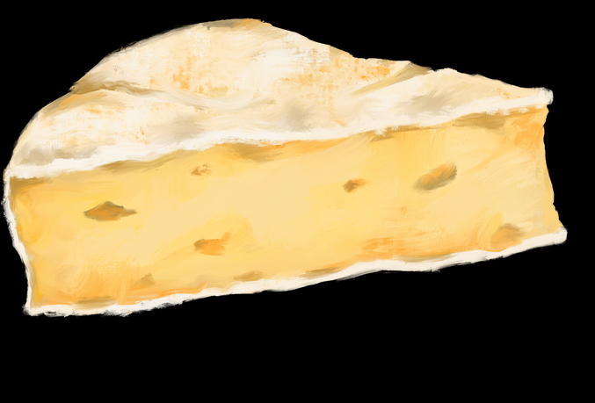
3
On-going diet - New or Continuing Symptoms
If you’re having new or ongoing issues with:
  Fatty foods
  Lactose - found in dairy products like milk, yoghurt, soft cheese
  Frequency, urgency, pain or changes in pouch function/symptoms
Please speak with your GP/surgical team for further tests and investigations.
Clemmie Oliver | NALM Clinic

Slide 18
3
On-going diet - Fluids & hydration
Hydration can be particularly challenging and important when we have a J-Pouch
Check your urine colour to check hydration status
Signs of mild dehydration include:
  Headache
  Thirst / dry mouth
  Tiredness / fatigue
  Poor concentration
  Darker urine
Clemmie Oliver | NALM Clinic
Notes:
Explain why hydration can be difficult with a J pouch.

Slide 19
3
On-going diet - Fluids & hydration
For fluids to be optimally absorbed by our body, a drink needs to have the right balance of three things:
Water + sugar + electrolytes
Together, the right balance of water, sugar and electrolytes make up the 'osmolarity' aka the concentration of a drink.
Clemmie Oliver | NALM Clinic
Notes:
The osmolarity of drinks is important for hydration because it determines how quickly fluids are absorbed by the body and how effectively they can replace lost fluids.

Slide 20


3
On-going diet - Fluids & hydration
Drinks with zero osmolarity:
(No sugar and salt)
Plain water
Drinks with high osmolarity:
(Lots of sugar / salt)
Concentrated fruit juice
Soft drinks
Some sugary sports drinks
When dehydrated/to support hydration:
Low/optimal osmolarity to support absorption and hydration
i.e. water with some sugar and salt
Clemmie Oliver | NALM Clinic
Notes:
Drinking only zero / high osmolarity drinks (plain water or fruit juice) could have a negative impact on hydration, if we are already dehydrated, as they can encourage water to be drawn out of the cells into the digestive tract (when we want it to be the other way round!).

Slide 21

3
On-going diet - Fluids & hydration
Key takeaways for fluid and hydration:
  Aim for around 2 litres of fluids per day - maybe more depending on weight and activity levels
  If you struggle with hydration, include some oral rehydration solutions (1 -2 sachets) – e.g. Dioralyte, SOS Hydration or Hydrostomate.
NB: if you have diabetes, kidney or liver failure ask your doctor before taking oral rehydration solutions.
Clemmie Oliver | NALM Clinic

Slide 22
Q&A
Clemmie Oliver | NALM Clinic

Slide 23
References
BDA (2020) Healthy Eating Food Fact Sheet. [online] Available from: BDA (2020) Healthy Eating Food Fact Sheet. [online] Available from: BDA (2020) Healthy Eating Food Fact Sheet. [online] Available from: BDA (2020) Healthy Eating Food Fact Sheet. [online] Available from:
Zallot and Peyrin-Biroulet. (2013) Deep Remission in Inflammatory Bowel Disease: Looking Beyond Symptoms. Curr Gastroenterol Rep 15, 315. https://doi.org/10.1007/s11894-013-0315-7
Zallot, Quilliot, Chevaux, et al. (2013) Dietary beliefs and behavior among inflammatory bowel disease patients. Inflamm Bowel Dis. 19(1):66-72.
doi: 10.1002/ibd.22965. PMID: 22467242. Accessed 08 August 23
Godny L, Reshef L, Pfeffer-Gik T, Goren I, Yanai H, Tulchinsky H, Gophna U, Dotan I. Adherence to the Mediterranean diet is associated with decreased fecal calprotectin in patients with ulcerative colitis after pouch surgery. Eur J Nutr. 2020 Oct;59(7):3183-3190. doi: 10.1007/s00394-019-02158-3. Epub 2019 Dec 7. PMID: 31813010
Godny L, Maharshak N, Reshef L et al (2019) Fruit consumption is associated with alterations in microbial composition and lower rates of pouchitis. J Crohns Colitis. https://doi. org/10.1093/ecco-jcc/jjz053
Ianco O, Tulchinsky H, Lusthaus M, et al. Diet of patients after pouch surgery may affect pouch inflammation. World J Gastroenterol. 2013;19(38):6458-6464. doi:10.3748/wjg.v19.i38.6458
Ardalan, ZS, Yao, CK, Sparrow, MP, Gibson, PR. Review article: the impact of diet on ileoanal pouch function and on the pathogenesis of pouchitis. Aliment Pharmacol Ther. 2020; 52: 1323– 1340.

