Slide 1
Diet & Pouches
Alice Gibson
Specialist Surgical Dietitian
Objectives:
Healthy eating with a Pouch.
Weight management.
Obstructions.
Symptoms of Pouch Dysfunction & commonly associated foods.
Remedies for Pouch Dysfunction.

Slide 2
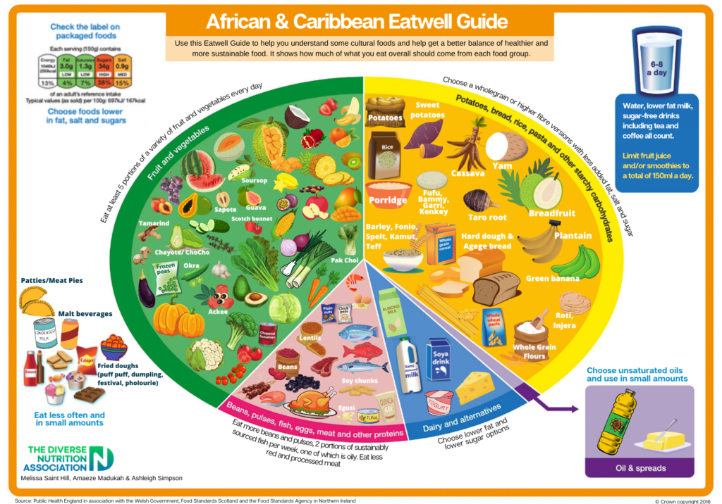
Healthy eating with a pouch.
Once your Pouch begins to adapt & you become used to its normal function, it is important to regain a balanced diet with variety.
Furthermore, if your weight falls into the ‘overweight’ or ‘obese’ category, you may be interested in weight management principles, once fully recovered.

Slide 3
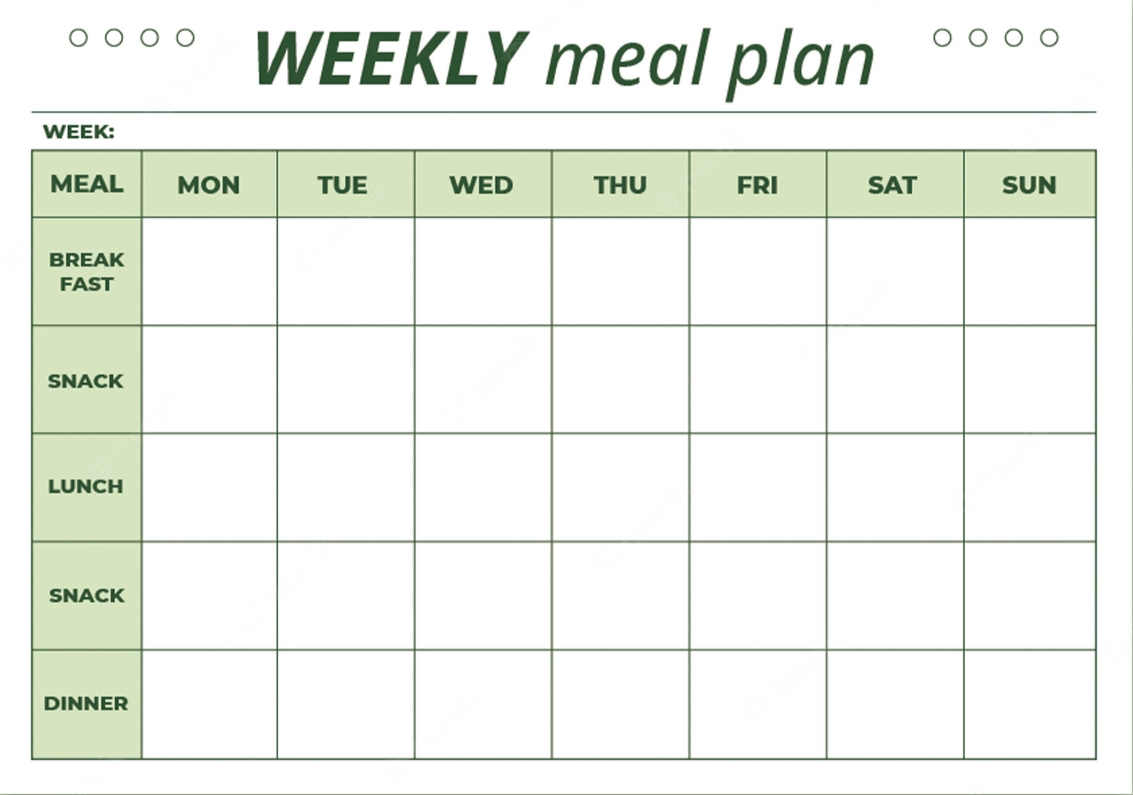
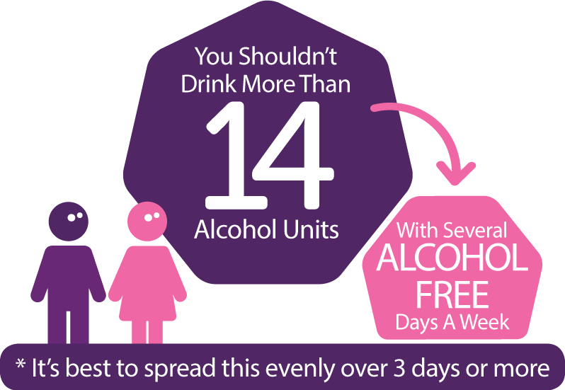
10 steps to weight management:
1. Eat regular meals.
2. Eat plenty of fruit & vegetables (more to follow!)
3. Increase activity levels.
4. Drink plenty of water.
5. Read food labels.
6. Eat mindfully.
7. Do not restrict foods.
8. Avoid stocking ‘junk’ foods.
9. Reduce alcohol consumption.
10. Plan your meals.
Myths:
Avoid carbohydrates (especially white versions).
Skip meals.
‘Low fat’, ‘reduced fat, ‘diet’ & ‘light’ products work best.
Cut out all snacks.
“Fad Diet” & “Super foods”.
Foods increase metabolism rate.

Slide 4
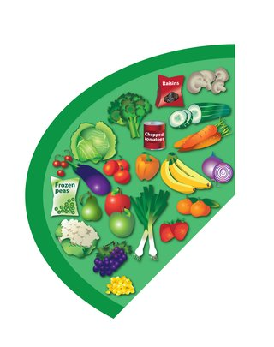
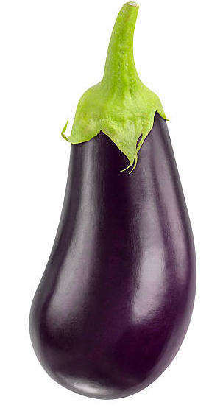
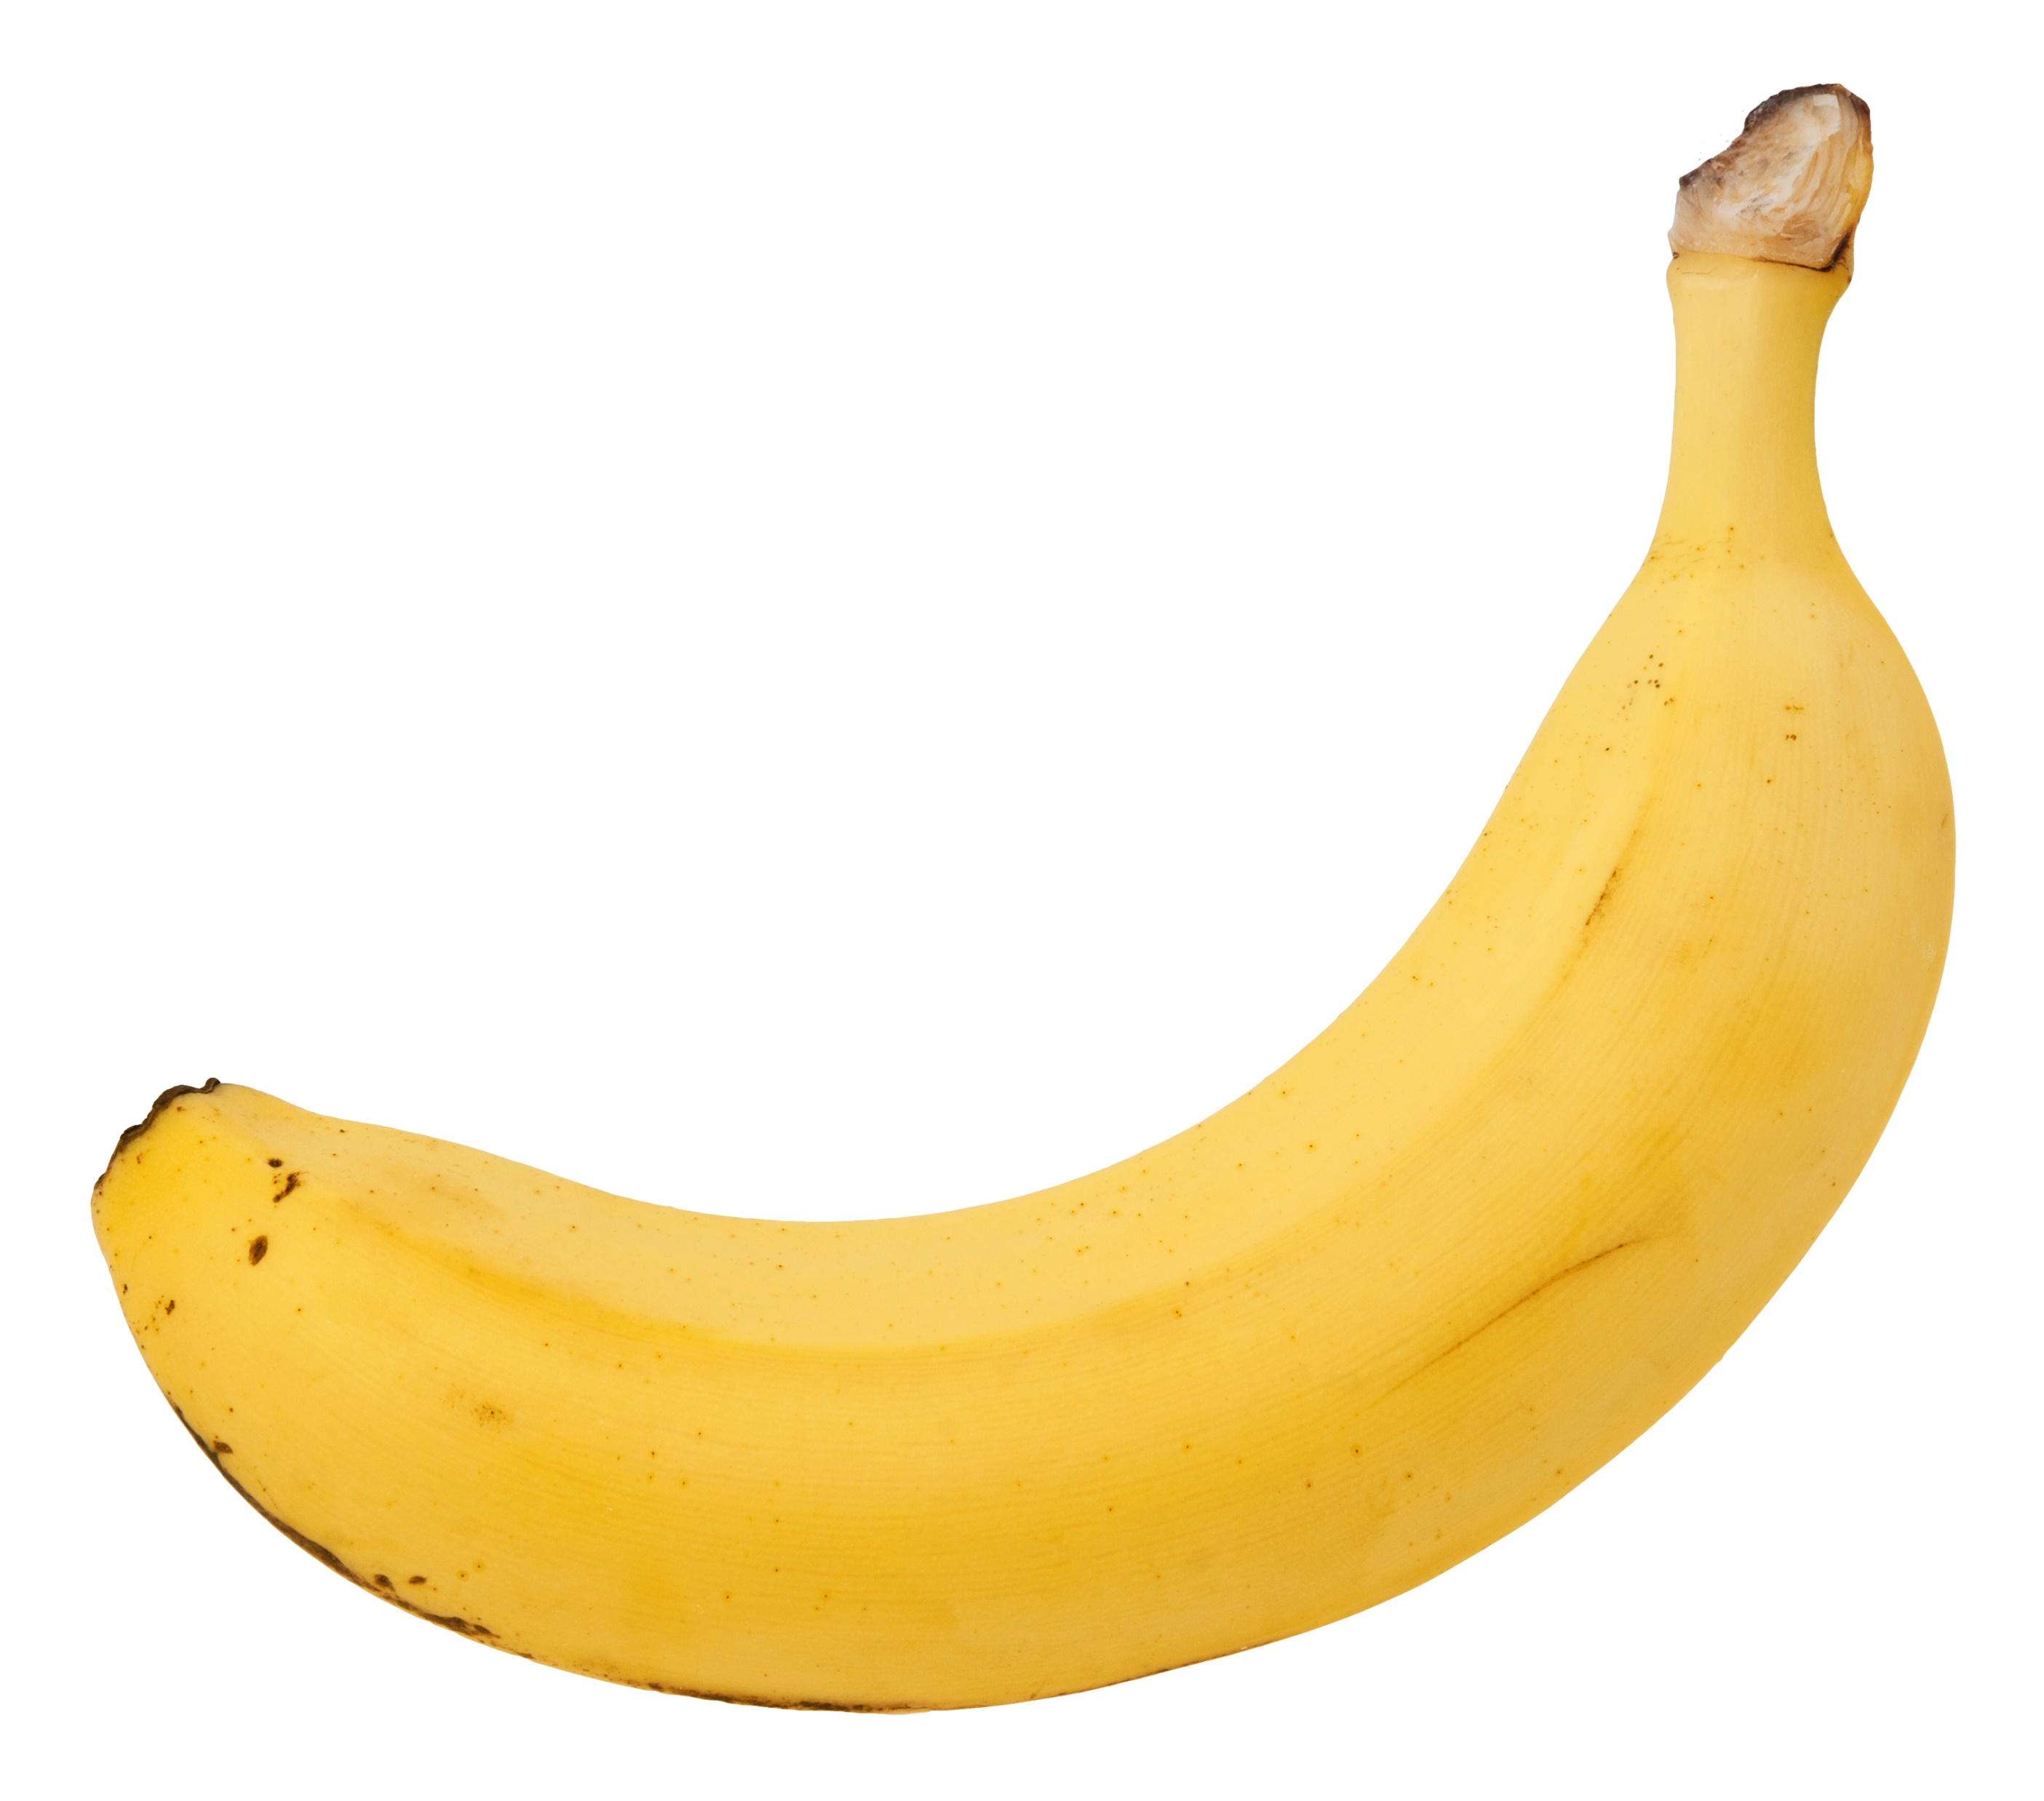
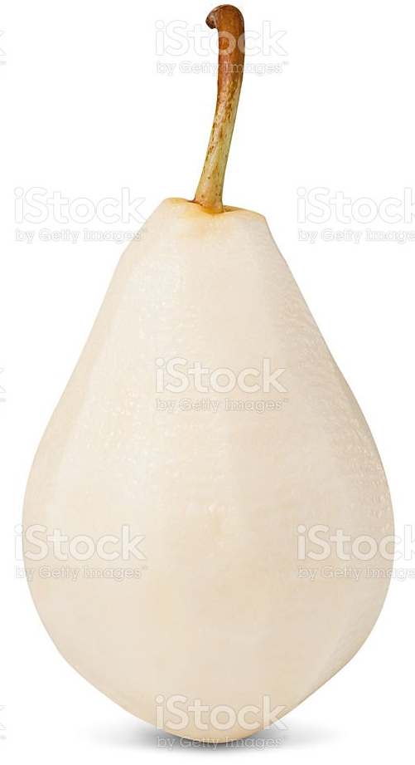
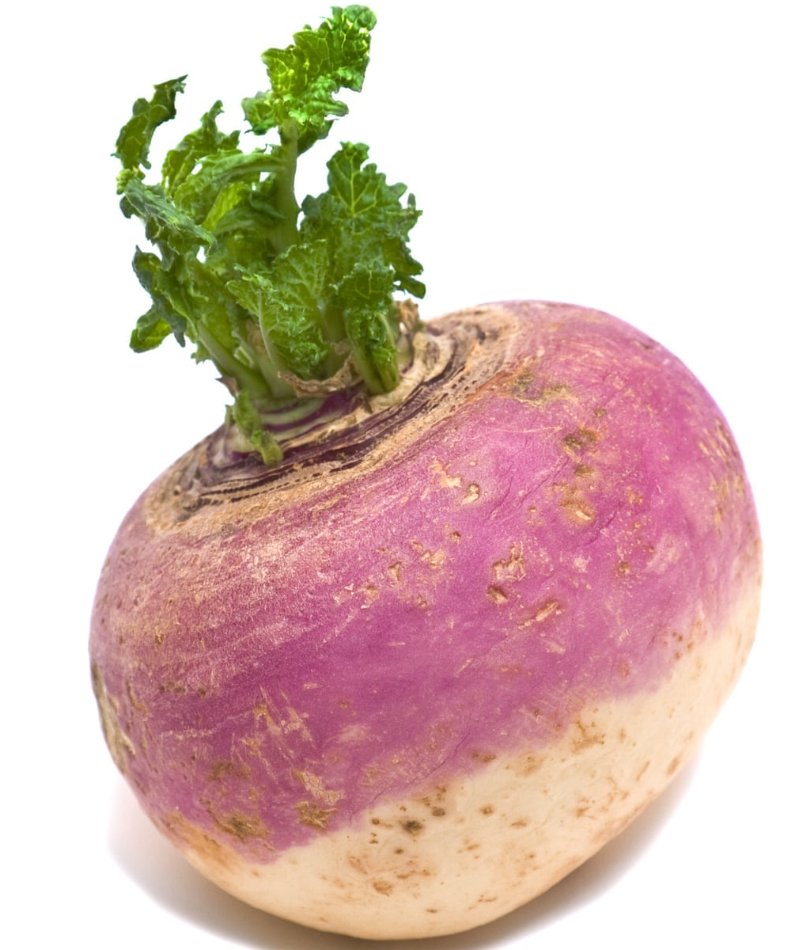
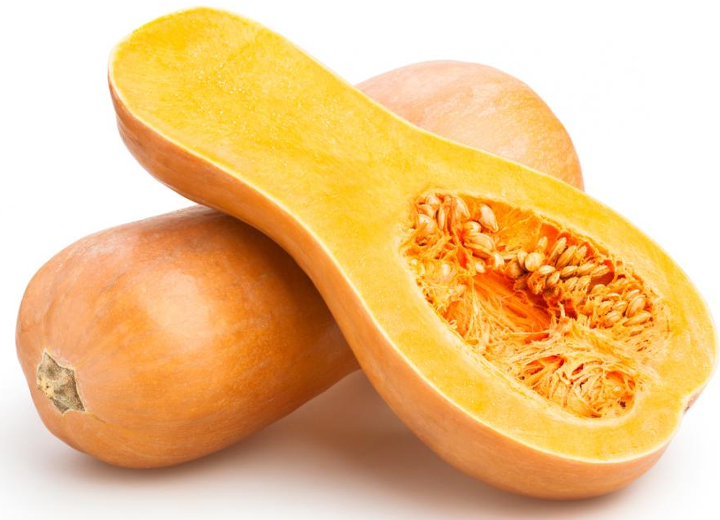
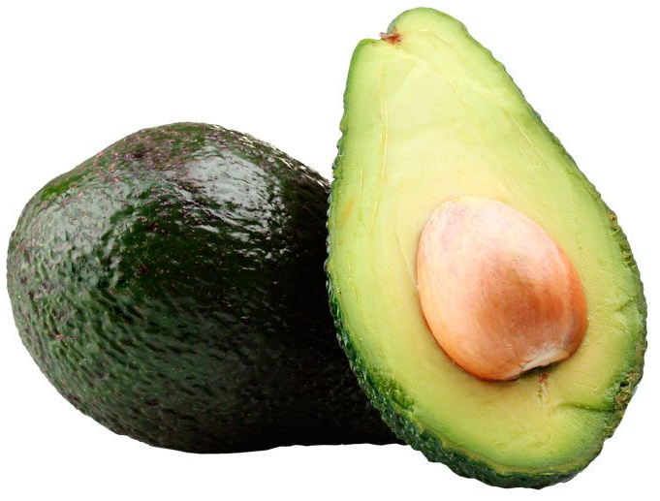
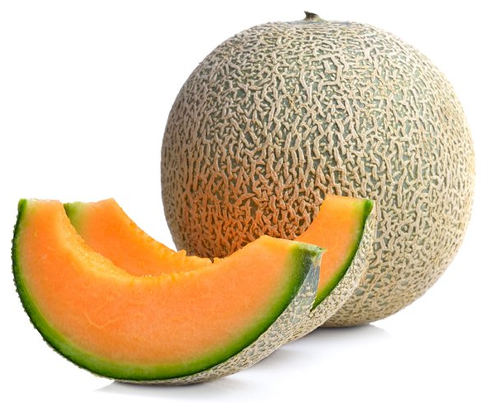
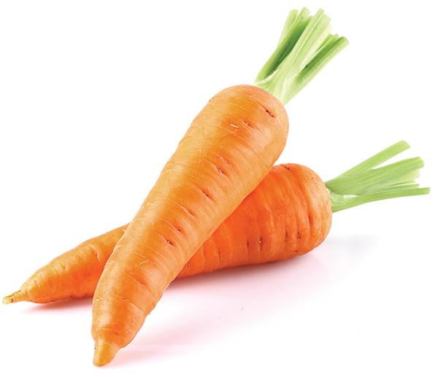
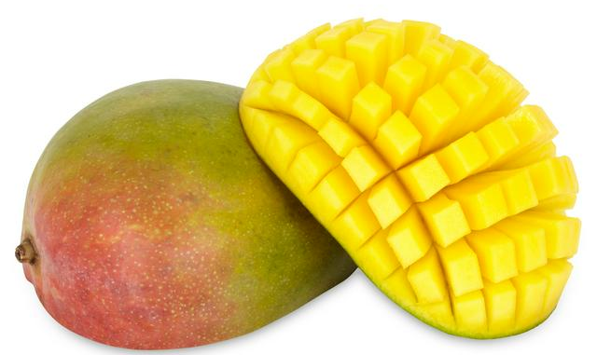
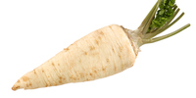
Fruits & vegetables provide a low calorie source of fibre and the vitamins/minerals which are important for a variety of bodily functions. Consequently, this food group is encouraged within weight management principles (i.e. “five a day”).
However, we appreciate that not everyone with a Pouch can tolerate this.
If you are someone who struggles with this, consider:
Removing skins & seeds where possible.
Prioritising vegetables over fruits.
Opting for tinned or stewed fruits.
Consuming unsweetened fruit juice (150ml/d).
Cooking vegetables well (i.e. in casseroles) or pureeing (i.e. in soup).
Chewing thoroughly.
Opting for lower fibre varieties.
Use of a daily multivitamin.

Slide 5
Intestinal obstruction
Having abdominal surgery increases the risk of scar tissue forming within the abdomen which can cause bowels to adhere together, kink & narrow, increasing the risk of an ‘obstruction’.
Symptoms, & thus dietary recommendations & impact upon nutritional status, can vary from person-to-person & throughout the ‘lifespan’ of the adhesions. Typically everyone will fall somewhere on the below spectrum:
Rarely/never obstructed
Infrequently obstructed
Frequently obstructed
Often obstructed
Unfortunately it is difficult to measure the impact of various dietary changes upon the risk of future obstructive episodes & it is important to avoid unnecessary dietary restrictions for a healthful, balanced diet.
Eat a varied diet without restriction.
‘Low residue diet’ avoiding some difficult to digest foods (i.e. skins/seeds/pips,) such as: peas, sweetcorn, popcorn, peppers, mushrooms, tomatoes, nuts etc.
‘Low fibre diet’ necessitating ‘white versions’ of breads / cereals & limited consumption of F&V.
Low fibre & soft/liquid diet, often requiring Dietetic Support.

Slide 6
Pouch Dysfunction
Symptom | Commonly associated foods:
Passing undigested foods. | Mushrooms, sweetcorn, potato skips, lentils, peas, nuts, seeds, peppers.
Increased stool frequency/loose stools. | Chocolate, coffee, spicy foods, alcohol, fried foods, sorbitol, high fibre.
Anal irritation. | Spicy foods & citrus fruits.
Abdominal bloating. | Fizzy drinks.
Increased wind. | Baked beans, Brussel sprouts, cabbage, cauliflower, alcohol, fizzy drinks.
Increased stool odour. | Fish, onions, garlic, eggs.
Please remember that everyone is different so foods which may upset one person may be tolerated well by another. Having a pouch does not always stop symptoms of IBS/intolerances. Therefore, try all foods and only avoid those which repeatedly cause unacceptable pouch function. Tolerance may change over time, so regularly retry small quantities of any avoided foods.

Slide 7
Alternative Remedies for Dysfunction
Wind:
Loose stool:
Bloating:
Avoid eating & drinking at the same time.
Avoid chewing gum.
Be mindful of talking whilst eating.
Chew thoroughly.
Avoid straws.
Eat at regular intervals (‘little & often approach).
Starchy CHO.
+ dehydration: Added salt diet. Oral Rehydration Solutions.
Trial having a main meal at midday.
?IBS management.
Medication.
Eat at regular intervals (‘little & often approach).
Peppermint tea/capsules.
Flat carbonated drinks.
Avoid long periods without eating.
Avoid slouching when eating.
Avoid large meals before bed.
?IBS management.

Slide 8
Thank you for listening!
any questions?

